Slide 1
Which Grace? Analysis of Historical Records of Enslaved People
NNCSS Conference February 3, 1028
Notes:
50 minute presentation

Slide 2
Lives Bound Together Quiz
Welcome!
While you are waiting for the session to start, use your cell phone to log into the website and take the Lives Bound Together Quiz and see how much you know about the topic of slavery at Mount Vernon.
http://www.mountvernon.org/quizzes/landing/lives-bound-together-quiz/

Slide 3
Lesson Objectives:
Use primary and secondary sources to learn about life as an enslaved person at Mount Vernon.
Evaluate primary sources to make a claim about historical evidence.
Learn about programming for educators at George Washington’s Mount Vernon.
Notes:
2 minutes

Slide 4
Introductions:
Lindsey Porter, Mendive Middle School
Marcia Motter-Johnson, Archie Clayton Pre-AP Academy
Notes:
3 minutes

Slide 5
Warm-Up Activity:
Map of General Washington’s Five Farms
Map of Mount Vernon Worksheet
Notes:
5 minutes to look at map
Complete the Map of Mount Vernon worksheet or a visual analysis using the Map Analysis from the National Archives.
A Map of General Washington’s Five Farms
Complete as a whole class
Focus on identifying the five different farms that George Washington owned. These farms are the locations where the enslaved people he owned also lived.

Slide 6
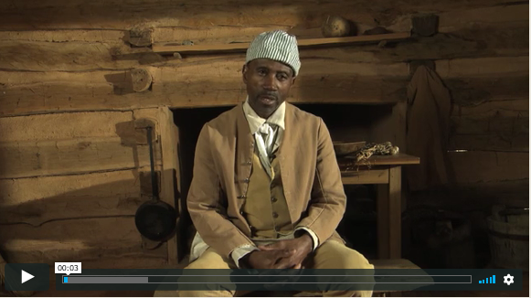
Priscilla and Joe:
Priscilla
Joe
Joe's Biographical Video
Notes:
9 minutes
Introduce Priscilla and Joe, two of the enslaved people who lived and worked on Washington’s farms.
Read: Excerpt : Biography of Priscilla and/or
Watch Joe’s biographical video- 4:23

Slide 7
Activate Thinking:
Imagine your are an enslaved married couple living on the Dogue Run and Mansion House farms at Mount Vernon.
What do you think your days are like?
Would weekdays and weekends be different?
Notes:
1 minute
Mention to participants; do not do today due to time constraints
Have students conduct a pre-write to activate their thinking.
Tell students, “Use your prior knowledge and the sources provided to answer the questions.”
Alternative for schools with technology available: allow students time to explore the Background Information sheet which includes on-line resources and articles.

Slide 8
You are the Historian:
Notes:
2 minutes
Inform students that historians were able to build the biographies of Priscilla, Joe, and other enslaved individuals who left now written record by using research skills that integrate numerous written records with what they know about Mount Vernon from archaeological, architectural, and curatorial work. As a class, you will be looking at the same evidence historians looked at to create our own narratives about the life of someone enslaved at Mount Vernon.

Slide 9
French’s Slave Census 1799
Locate Isaac on the census
Locate Grace on the census
Locate Sukey on the census
Notes:
5 minutes
Show students the document and transcription titled French’s Slave Census 1799.
Historians used this source, along with hundreds of letters, ledgers, farm reports, and other documents dated from 1750 to 1800, to find evidence of individual enslaved peoples’ names.
As a class, locate Isaac on the census, then look for Grace. Ask students to find Suckey. Note: Grace and Isaac are listed on the census, Suckey is not.
There were numerous enslaved people named Grace, Isaac, and Suckey who lived on Washington’s five farms; however, there is no record of exactly how many different individuals with those names there were over the 50 years that Washington held slaves.

Slide 10
How many enslaved individuals named Grace, Isaac, and Suckey were there at Mount Vernon from 1750-1799?
Directions:
Review pieces of evidence
Sort source cards into piles according to the number of individuals you think lived on Mount Vernon with the name your were assigned
Hints: look for dates, location, owner, text of the event, and name of primary source document
Notes:
10 minutes
Divide students into groups and provide each group with a set of sources. Assign each group a complete set for Grace, Isaac or Suckey; distribute a portion of each set (just the even or odd numbered cards for Grace, Isaac, or Suckey); or evenly divide one set of sources between your groups.
Review the research question with students-provide starting tips to help the groups use their time with the sources wisely. (Pass out Key to Resources in page protector to each group as a reference.)
Tell students to review the pieces of evidence and sort their source cards in to piles according to the number of individuals they think lived on Mount Vernon with the name they were assigned in their source set (each pile represents and individual and contains the source cards with evidence eg. 5 piles for 5 different Isaacs, etc…) Refer to the Starting and Stumbling Tips for Teachers handout for prompts to get students started with this activity.
In a class with students, allow 20-30 minutes for groups to review evidence and fill out their Student Worksheet.
Instruct groups to present their findings and share with their peers if they reached consensus on the number of individuals with the name they were assigned.
If there was no consensus, students should explain why they disagreed using evidence from the source set.

Slide 11
Class Debrief:
How much did you trust the sources available to you?
Where else could you find more information about the lives of those enslaved at Mount Vernon? How do we find stories about people who did not leave a written record?
Do the stories of peoples’ lives change even when events of the past do not? What causes a story of the past to change?
Notes:
5 minutes

Slide 12
Mount Vernon Resources:
Resources
Notes:
5 minutes

Slide 13
www.mountvernon.org
Notes:
3 minutes
Explain about the teacher institutes:
Free for educators
3 per year
4 day immersive institute, learning All expenses paid
Taught by top scholars in the field
You are a guest of the Washington’s while you are there.
You live on the estate while you are there
Best pd I have ever attended.

Slide 14
Notes:
5 minutes
Field any questions from the group

Slide 15
l.porter@washoeschools.net
mmotter@washoeschools.net
Notes:
3 minutes
Quick evaluation for Mount Vernon; have participants leave on their desk when they leave

