Slide 1
Vocabulary is the Key to Inquiry
Kacey Edgington

Slide 2
Why vocabulary?
Of all the features of complex text, vocabulary is the one that best predicts students’ comprehension. It is also the feature of complex text that is the most straightforward to teach.
https://www.youtube.com/watch?v=q-K9dSH_jhQ

Slide 3
Nine Proven Approaches by Catherine Snow http://wordgen.serpmedia.org/vocabulary-instruction.html
Pick generative words
Ensure recurrent exposures
Provide opportunities to use the words
Present words in semantically-rich contexts
Teach word-learning strategies
Provide learner-friendly definitions
Expand each word’s semantic mapping
Cultivate “word awareness”
Encourage experimentation, expect mistakes
Notes:
Choose one strategy you do really well and one strategy you’d like to do better. Share with a partner.

Slide 4
How do we engage in continuous vocabulary learning?
Resource
Research
Instructional Move

Slide 5
Increasing Young Low-Income Children’s Oral Vocabulary Repertoires through Rich and Focused Instruction
Research
Higher SES
30 million words of spoken language
1,100 word vocabulary
Middle SES
20 million words of spoken language
700 word vocabulary
Lower SES
10 million words of spoken language
500 word vocabulary

Slide 6
Resource
Inquiries!
Kinder | First | Second | Third | Fourth | Fifth | Sixth
How can we be responsible and cooperate in our classroom? | What was life like in the past for people in our community? | Should kids have to work a full-time job? 1870-1914 Child Labor in the Industrial Revolution | How are rules and laws different throughout the world? | Indian Boarding Schools | What caused the Salem Witch Trial Hysteria? | How Great was Alexander the Great?
Responsibility Cooperation | Progress Change Memory | Labor Legal Century Reform Conditions | Fair Equal Equality Just Justice | Deficient Dormitory Boarding | Puritans Paranoia Hallucinogen Protestant | Integrity Legend Phalanx Crucify

Slide 7
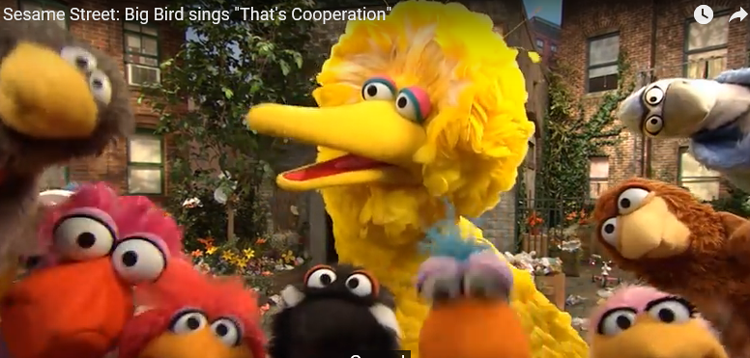
Inquiry Vocabulary Chart
Instructional Move
Word | Context | Student Friendly Definition | Picture | Tally Mark for Usage
Cooperation | If we put our heads together we’ll figure it out. That’s cooperation! | Working Together |  | II
Tips:
Ongoing
Large clear print
Public
Interactive
Chart of reference

Slide 8
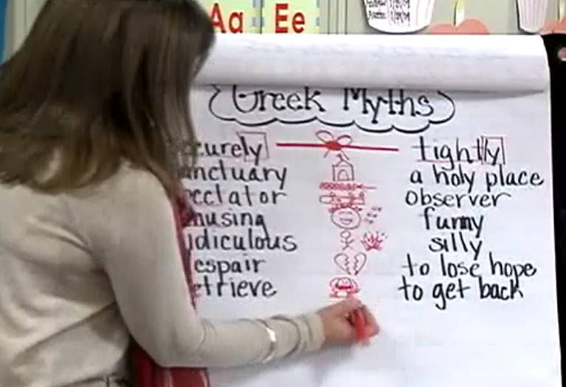
Guess My Word
Instructional Move
Notes:
9:27- 11:14

Slide 9
How do we develop and write reasoning that supports the vocabulary of a claim?
Resource
Understanding
Instructional Move

Slide 10
Matching Evidence to the Vocabulary of a Claim
Notes:
Pass out Arguementative/Opinion Writing Terms

Slide 11
Cooperative Strip Paragraph
Resource
Teacher shares a claim.
The class generates evidence to support the claim.
Each group writes a reasoning sentence for the evidence.
These sentences are added to a pocket chart.
Editing occurs.
A concluding statement and title is co-created.

Slide 12
Kindergarten Inquiry: Responsibility and Cooperation
CLAIM
A classroom community acts responsibly and show cooperation.
Our class is respectful by helping each other when they are sad.
Our table group is a team because we share supplies.
Tom is good listener by looking at her partner Jesus.
EVIDENCE
Notes:
Kinder evidence is coming from their head, a picture or a shared experience

Slide 13
CLAIM
REASONING
EVIDENCE
Our Class
A classroom community acts responsibly and shows cooperation.
It is important to help each other in our classroom. We show responsibility and cooperation by listening to each other. For example Tom looked at his partner Jesus when he was talking yesterday. This is important because we all have to work together in our class to be responsible and cooperative. We also share our classroom supplies. This proves we are a responsible and cooperative classroom of learners.

Slide 14
Second Grade Inquiry: Should Kids Have to Work a Full-Time Job?
CLAIM
1
The Labor Laws positively reformed to protect workers’ rights over the past century.
The average pay was 70 cents a day. The current minimum wage is $8.25.
The Breaker Boys started working at the age of 8. In contrast, current laws set the age at 14.
The working conditions were unsafe and dangerous for children. Most worked 12 hour days six days a week. Now legal workers must be 18 for dangerous jobs and they cannot work during school hours.
2
EVIDENCE
3
Notes:
#3 was the strongest evidence
Evidence coming from the text

Slide 15
CLAIM
REASONING
EVIDENCE
The Labor Laws positively reformed to protect workers’ rights over the past century.
The working conditions were unsafe and dangerous for children. Most worked 12 hour days six days a week. Now legal workers must be 18 for dangerous jobs and they cannot work during school hours.
It can be claimed that the U.S. Congress was instrumental in reforming workers’ rights by passing the Fair Labor Standards Act in 1938.
Notes:
In a group, use the evidence to guide your reasoning statement.
Walk around and select the reasoning statement that has the best explanation and elaboration for the “why”

Slide 16
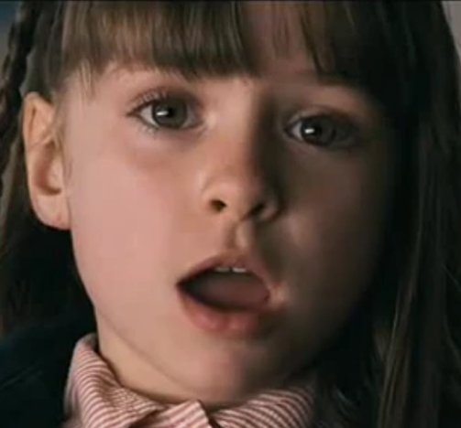
What is missing from her argument?
My Dad’s an Alien!
Notes:
http://www.bing.com/videos/search?q=claim+evidence+and+reasoning+in+social+studies&&view=detail&mid=8F5AF76E89A9654696218F5AF76E89A965469621&&FORM=VDRVRV
What is missing from her argument?

Slide 17
Thank you! Have a wonderful afternoon!

Slide 18
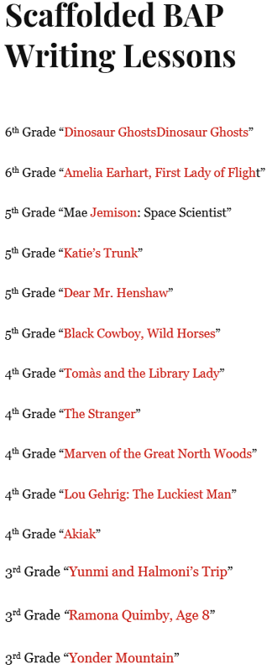
3rd-6th Grade
63000resources.com
ELA Dropdown Menu
Select Basal Alignment Project
Select Scaffolded BAP Writing Lessons

Slide 19
