Slide 1
Islamic Terrorists Propaganda
An Insight Into the Machine
Mario Fitzpatrick: Hug High School
Katie Anderson: Teaching American History Project

Slide 2
What is propaganda?
Propaganda comes in many forms and definitions. Some examples are:
ideas or statements that are often false or exaggerated and that are spread in order to help a cause, a political leader, a government, etc.- Merriam- Webster
information, ideas, or rumors deliberately spread widely to help or harm a person, group, movement, institution, nation, etc.- dictionary.com
derogatory information, especially of a biased or misleading nature, used to promote or publicize a particular political cause or point of view- Oxford English Dictionary

Slide 3
Objectives of terrorist Propaganda
Almost all terrorist propaganda has the at least one of the following objectives:
Gain support for their cause
Recruit new participants
Radicalize the population
Promote martyrdom
Mark significant events within their cause

Slide 4
Who Do Terrorists target For Recruitment?
Terrorist propaganda target many groups but their main focus tends to be:
Young single males- This has grown to include Americans and Europeans as well as Muslims from the Middle East.
Wealthy Muslims- People willing to fund terrorists operations.
General populations- Mainly middle eastern countries where there is a direct struggle for power such as Iraq or Syria.

Slide 5
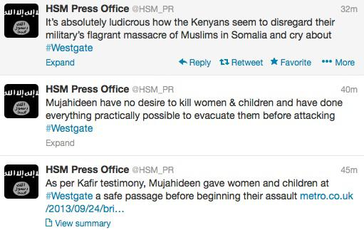
How do Terrorists get the message out?
Terrorists use many mediums to get their message out to the public.
Twitter
Facebook
YouTube
Magazines
Terrorists attacks

Slide 6
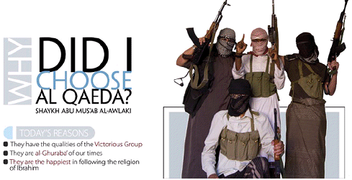

Slide 7
Tools in the Propaganda kit
Terrorists groups tend to use a plethora of the following tools in order to achieve their goal:
Demonization: This is used to make the enemy seem more evil than it is, such as portraying Israelis as devilish.
Martyrdom: Propaganda shows images promoting actions that represent martyrdom, dying in the name of Allah for the cause.
Symbolism: There are many different symbols used in terrorist propaganda such as doves flying symbolizing a soul passing over or flames for pain and a yearning to be reunited with Allah.
Jihadism/ Perseverance: This tool is used to show bravery, sacrifice and dedication to the cause.

Slide 8
What does this all mean?
Terrorism has become a significant global concern
It is part of our history in America and the world. For our students to understand these global conflicts, it is helpful why radical groups become involved and how they influence events.
As terrorism shifts from a handful of prominent groups to several splinter groups around the world it is important to understand how and why terrorists are able to reenergize their ranks.
Additionally, as the world becomes smaller and technology becomes greater we are finding more recruits coming form nontraditional sources such as right here in America.
If we can learn from their rationale, then, at the very least, we can start to have conversations about how to address the issue.

Slide 9
Analyzing a Terrorist propaganda Poster
Resources are compiled from the Militant Imagery Project from the Combating Terrorism Center at West Point. (www.ctc.usama.edu)
“The Combating Terrorism Center is an independent,
privately funded, research and educational institution situated at West Point
that contributes to the academic body of knowledge and informs
counter terrorism policy and strategy.”
Its role is to:
Teach cadets on terrorism and counterterrorism
Research the dynamic and evolving terrorist threat
Advise federal, state and local governments within their counter terrorism operations.

Slide 10
Using Art to Identify Evidence and form claims with reasoning in an argument
ART AND ARGUMENT : Art sources can provide a great visual entrée to writing and substantiating claims.
Appeals to visual learners
Forces students to think as writers without the intimidation of complex text
Great way to practice as using art can take less time than reading a traditional text

Slide 11
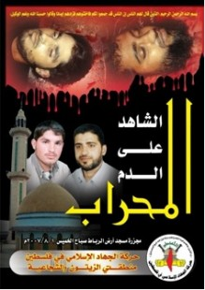
Think Aloud Example: Image Commemorating JAA members Killed by Hamas
1: Evidence: “What I see”
a mosque, the same men twice- alive and dead, a logo, arabic writing, a fence, red sky/blood
Claims: “What I think”
The men in the photograph died for their religious beliefs. They are martyrs.
The dead men are in heaven
The poster is commemorating the men’s commitment to the cause being identified through the text.
Reasoning: “How I know”
a. The men in the photograph are martyrs because they are shown alive and dead. The images of them as dead men is surrounded by red which symbolized blood and sacrifice. Their dead images are also at the top of the poster which symbolizes heaven.

Slide 12
Analyze a poster
Review Worksheet: Any questions?
Organize yourselves into groups of 2-4.
In your groups, STUDY THE IMAGE QUIETLY FOR TWO MINUTES
In your groups, work through Steps 1-4. Be specific and unafraid!
Step 5: Reveal the blue sheet and read the official analysis of the image.
Step 6: Final Reasoning:
Step 7: Cultural Competency and Multiple Perspectives

