Slide 1
Teaching Students to Ask Effective Questions Using the QFT
Kelly Barber
WCSD STEM Coordinator
kbarber@washoeschools.net

Slide 2
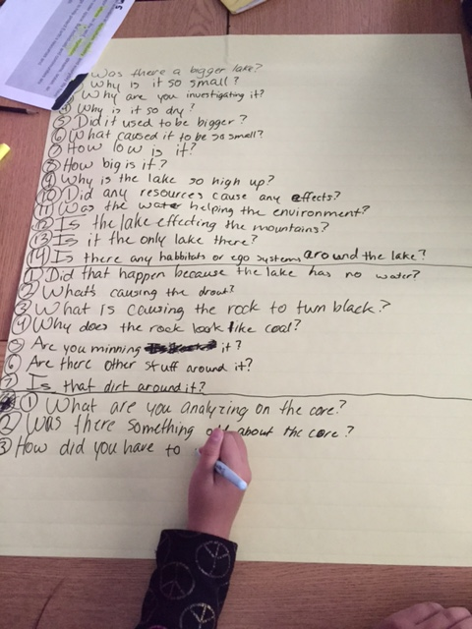
Essential Question
How do we build student capacity to ask their own questions?

Slide 3
A question can take you anywhere
Notes:
2 min
Be reflective.
Why would we want our students to be asking question? How do we get them to ask the questions that they need to?

Slide 4
"There is no learning without having to pose a question." -Richard Feynman Nobel-Prizewinning physicist

Slide 5
Research on the Importance of Student Questioning
Self-questioning (metacognitive strategy):
Student formulation of their own questions is one of the most effective metacognitive strategies
Engaging in pre-lesson self-questioning improved students rate of learning by nearly 50% (Hattie, p.193)
John Hattie
Visible Learning: A Synthesis of Over 800
meta-Analyses Relating to Achievement, 2008

Slide 6
NVACS for Social Studies
…students need the intellectual power to recognize societal problems; ask good questions and develop robust investigations into them; consider possible solutions and consequences; separate evidence-based claims from parochial opinions; and communicate and act upon what they learn.
.
The standards help educators create a student-centered approach to social studies in which critical skills and inquiry are the focus, rather than rote memorization of facts.
The aim is to create lifelong learners who are equipped with the skills and knowledge to shape our nation’s democratic institutions and respond to any challenge they may meet in the future.

Slide 7
NVACS for Social Studies
SS.K.1
With prompting and support, generate compelling questions to explore how learning and working together builds a classroom community.
.
SS.1.1
With prompting and support, generate compelling questions to explore the places people live and work
Generate compelling questions to explore the creation of the United States.
SS.5.1
Generate and answer supporting questions while explaining how they contribute to an inquiry and how new compelling and supporting questions emerge through the inquiry process.
SS.9-12.WH5

Slide 8
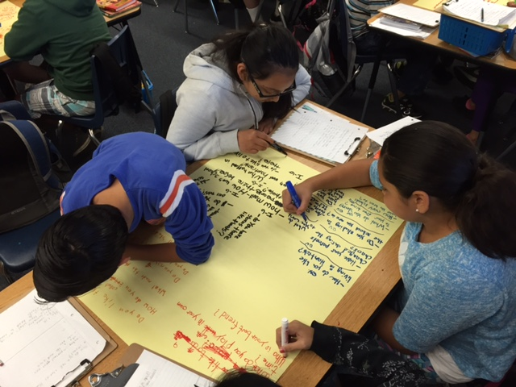
How do we teach our students to ask the questions?
Notes:
2 min.
These are pictures of students at LPES working through the QFT. As you can see, their “format” looks slightly different. The ultimate goal….GET THEM TO ASK QUESTIONS.

Slide 9
Introducing the Question Formulation Technique Into Your Classroom

Slide 10
WHAT IS THE QUESTION FORMULATION TECHNIQUE™?
The Question Formulation Technique (QFT) is a simple, but rigorous, step-by-step process designed to help students produce, improve and strategize on how to use their questions.
The QFT allows students to practice three thinking abilities in one process: divergent, convergent and metacognitive thinking.
Notes:
2 min

Slide 11
Choosing a Q Focus
The QFocus should be designed to accomplish one or more of the following:
Generate Interest
Stimulate New Thinking
Introduce a Topic
Set a Learning Agenda
Deepen Comprehension
Formative Assessment
Notes:
2 min

Slide 12
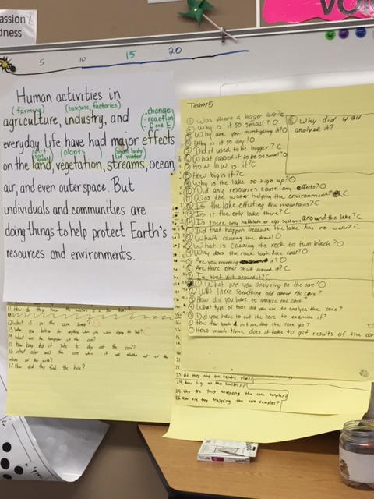
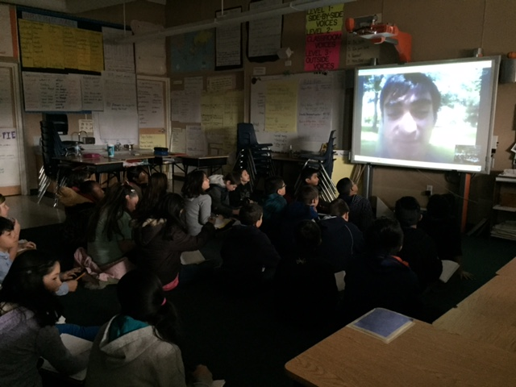
The QFT in a 5th grade classroom was used to develop questions to ask a guest speaker
Notes:
Ben talks about his classroom. How their questions went from very surface level, like “Is there only one lake?” which didn’t touch on the standard, to “What did you learn when you analyzed the core sample?” “What tools did you use to analyze the core sample?” So now they’re touching on the standard and the practice of “doing” science.

Slide 13
Your Turn
Engage in the QFT as a student to experience the process
If you have “teacher” questions write them on a sticky note

Slide 14
RULES FOR PRODUCING QUESTIONS
Ask as many questions as you can
Do not stop to discuss, judge or answer the questions
Write down every question exactly as it is stated
Change any statement into a question
www.rightquestion.org
Notes:
2 min
You would review these rules with your students. I’ve written them on chart paper so they are up the whole time while going through the process, so that if students need a friendly reminder of the rules, you have them to refer to. Once you’ve reviewed them ask your students which one they think would be the hardest to do and why. I always talk about how I, as a teacher, have a hard time with #2, because I get so excited about the great questions they ask that it’s hard for me to not “judge” by saying, “Oh, that’s a great question!”
TIP: give roles: Recorder, “Sheriff” – someone to make sure they follow the rules

Slide 15
STEP #1: PRODUCING THE QUESTIONS
QFocus:
Follow the Rules for Producing Questions
Ask as many questions as you can
Do not stop to discuss, judge or answer the questions
Write down every question exactly as it is stated
Change any statement into a question
2. Number your questions
Some students are not asking questions.
www.rightquestion.org
Notes:
10 minutes (No later than an half an hour into presentation!! Shoot for 20 minutes into presentation)
Materials: Chart paper, markers,
Here is our Qfocus: They can be pictures, diagrams, statements, videos, etc. Take this Q-focus picture and we’d like you to think like your students. Or perhaps, you aren’t familiar with this and/or what it represents, so ask the questions you need answered.
Follow the steps on the PP.
Discuss differentiation on grade levels K-1 possibly teacher writing questions students ask. Partner, Group work, Individual questions. Depends on your purpose.

Slide 16
STEP #2: CATEGORIZE THE QUESTIONS
Closed-ended questions – they can be answered with “yes” or “no” or with one word.
Open-ended questions – they require an explanation and cannot be answered with yes” or “no” or with one word.
www.rightquestion.org
Notes:
2 min.
“Right there” vs “Think Questions” etc
Depending on the grade level, this step can be omitted. Some resources say K-2, but if there is a different verbage that is used in the classroom, this could be kept in.

Slide 17
STEP #2: CATEGORIZE YOUR QUESTIONS
Identify closed- and open-ended questions.
Mark the closed-ended questions with a C and the open-ended questions with an O.
Notes:
5 min
Have them identify

Slide 18
STEP #2 CATEGORIZING THE QUESTIONS
What are the advantages of open ended questions?
What are the disadvantages to open ended questions?
What are the advantages of close ended questions?
What are the disadvantages to close ended questions?
www.rightquestion.org
Notes:
5-7 min
dicusssion of above questions.

Slide 19
STEP #2: CATEGORIZE YOUR QUESTIONS
Review your list of questions and change one closed-ended question into an open-ended.
Then, change one open-ended question into a closed-ended one.
Notes:
5-7 min.
Follow PP, quick share out if time.

Slide 20
STEP #3: PRIORITIZE YOUR QUESTIONS
Choose the three most important questions from your list.
Keep in mind the QFocus.
Mark each priority question with an “X”
Notes:
3 min
If you use Essential Questions, this is a great time to redirect their attention to the EQ and ask them which questions might help them answer the essential question or develop research to study the EQ. If working on projects that they are doing their own research on, what questions could guide their research, etc.

Slide 21
STEP #3: SHARE YOUR QUESTIONS
Share with the group:
your three priority questions
your rationale for selecting those three
the numbers of your priority questions
Notes:
Share out 10-15 minutes.

Slide 22
STEP #4: NEXT STEPS
Discuss at your table:
What would you have your students do with their three priority questions?

Slide 23
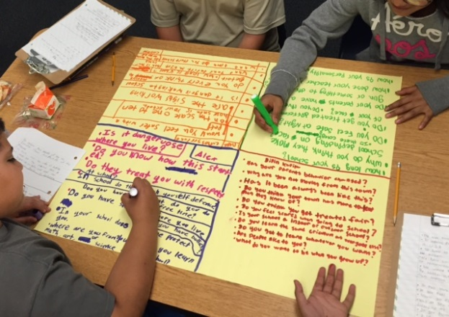
USING STUDENT QUESTIONS
Students can use their questions for many purposes, including the following:
Conduct Research
Reports
Conduct Experiments
Independent Projects
Write Papers/Essays
Group and Individual Projects
Socratic Seminars/Debates
Prepare for Presentations/Interviews

Slide 24
Classroom Example Using a Quote
Question Focus
“The disciplinary policies of our society perpetuate injustice.”
Notes:
Note - this is an image I found online.

Slide 25
Classroom Example Using a Photograph
Question Focus
Notes:
Note - this is an image I found online.

Slide 26
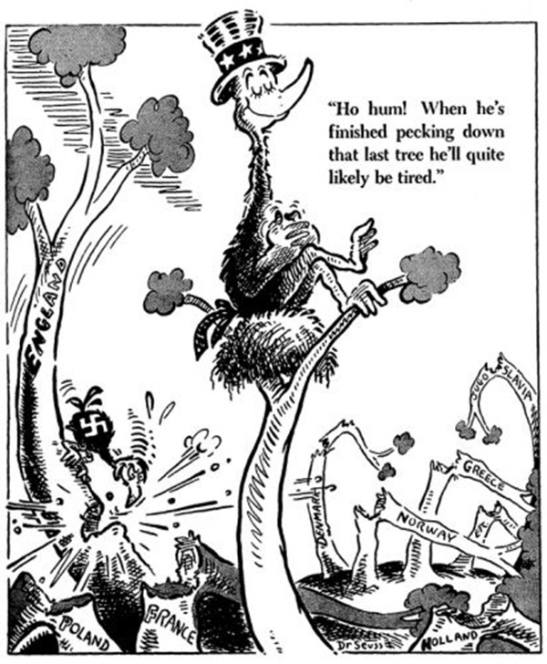
Classroom Example Using a Political Cartoon
Question Focus
Notes:
Note - this is an image I found online.
In social studies QFT is often used to introduce a new topic. Sometimes our Question Focus is a very compelling images (see some examples below). I’ve even used QFT with three different documents from a DBQ and seen great results. I would say the students noticed more about the sources when asking questions than when answering them.
Also, along with all the ways you have listed, it can be used to generate questions on an inquiry topic. As you noted in your slides, developing supporting questions is a standard at every grade level.

Slide 27
Next Steps
How will you use the QFT in your classroom to build the capacity of your students in asking their own questions?

Slide 28
The QFT, on one slide…
Question Focus
Produce Your Questions
Follow the rules
Number your questions
Improve Your Questions
Categorize questions as Closed or Open-ended
Change questions from one type to another
Prioritize Your Questions
Share & Discuss Next Steps
Reflect
Ask as many questions as you can
Do not stop to discuss, judge or answer
Record exactly as stated
Change statements into questions
Closed-Ended:
Answered with “yes,” “no” or one word
Open-Ended: Require longer explanation

Slide 29
The Skill of Asking Questions
Moving from ignorance as weakness to ignorance as opportunity
Arriving at better answers (and more questions)
Increasing engagement and ownership
Demonstrating inquiry in the classroom
And…

Slide 30
Democracy
“We need to be taught to study rather than to believe, to inquire rather than to affirm.” - Septima Clark
See Chapter 6 on Septima Clark in Freedom Road: Adult Education of African Americans (Peterson, 1996).

Slide 31
Resources
Information about the QFT can also be found here:
Make just one change: Teach Students to Ask
Their Own Question
By Dan Rothstein and Luz Santana
www.therightquestion.org
Videos of the QFT in action
Template for facilitating the QFT with your students
Student handouts
Blog
TED X Talk : https://www.youtube.com/watch?v=_JdczdsYBNA

Slide 32
Optimistic Closure
How and when will you introduce the QFT into your classroom with your students?
Notes:
5-7 min.
Follow PP, quick share out if time.

Slide 33
Questions?
Kelly Barber
kbarber@washoeschools.nmet

