Slide 1
NOVICE TEACHER FEEDBACK WORKSHOP
March 5, 2016
Presented by:
Sarah Brown, Spanish Springs High School
Marcia Motter, Archie Clayton Pre-AP Academy

Slide 2
Introductions
Participating veteran teachers:
Sarah brown, Spanish Springs High School, DL
Lindsey Clewell, Mendive Middle School, IL
Sue Davis, Retired WCSD Social Studies coordinator
Sonia Kretschmer, Hug High School
Marcia Motter, Archie clayton pre-ap academy, IS
Janet Roberts, hug high school, DL
Jamie Thomsen, Depoali Middle School, IL
Jamie Vaughn, AACT, DL

Slide 3
Workshop Objectives
Discuss/review ccss shifts and wcsd scope & sequence
Evaluate approaches to lesson design
Self-assess individual unit/lesson plans
Receive feedback & coaching regarding lesson plan development in small groups

Slide 4
Essential question
How can we design rigorous, text based lessons aligned to Nevada academic standards (NVACS) that help all students achieve?

Slide 5
CCSS ELA Shifts guiding social studies teachers
Regular practice with complex text and its academic language
Reading, writing and speaking grounded in evidence from text, both literary and informational
Building knowledge through content rich non-fiction

Slide 6
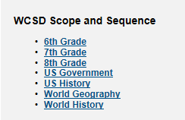
WCSD Scope and sequence

Slide 8
Lesson plan continuum

Slide 9
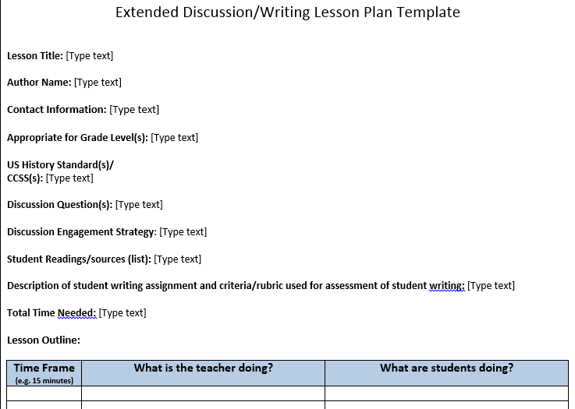
Lesson plan template http://projecttahoe.org/

Slide 10
Self-assessment
Please take the next 10-15 minutes to complete the self-assessment worksheet.
This worksheet and your responses will guide the coaching session with veteran teachers.

Slide 11
Concluding Discussion/Questions
In what ways can veteran teachers continue to support new social studies teachers?
What resources or workshops might be beneficial to new teachers?

Slide 12
Recommended sites
www.projecttahoe.org
www.achievethecore.org
http://sheg.standord,.edu/rhl

