Slide 1
Quotation Mingles
Jessica Cunningham
Galena High School

Slide 2
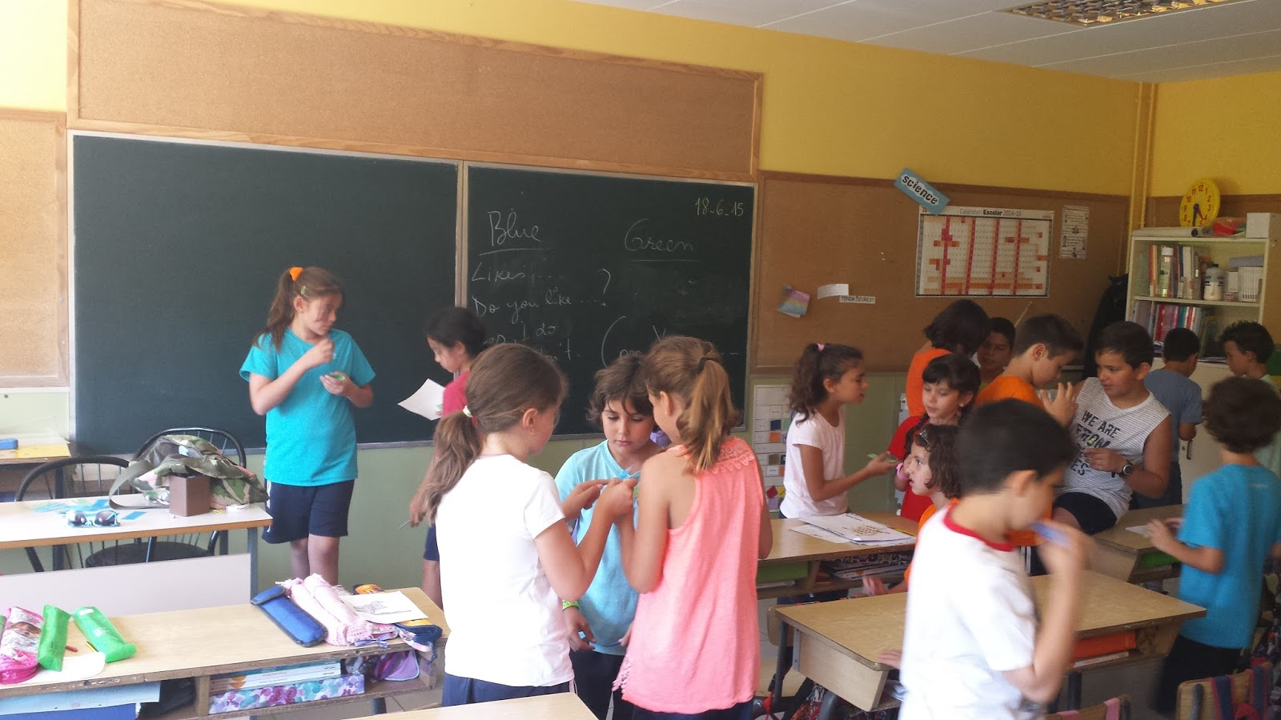
What is a Quotation Mingle?
Break up difficult text
Auditory and verbal rehearsal of text

Slide 3
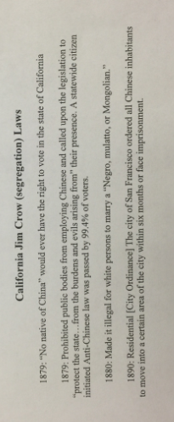
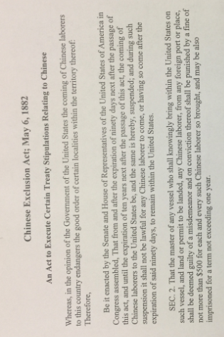
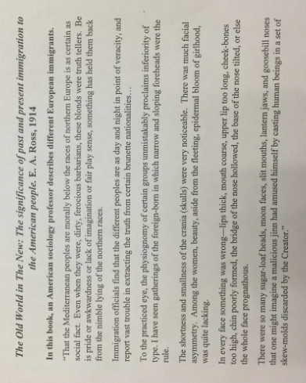
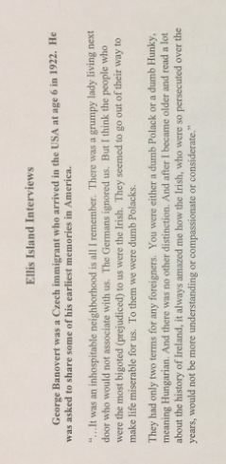
Disciplinary Purpose: Evidence Selection

Slide 4
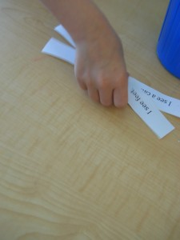
Quotation
You will get a strip of paper. Read it to yourself and put it in your own words in your head. Sit quietly when you finish.

Slide 5
Mingle!
You will get up and “mingle” with your classmates.
Find another student and read your strip aloud to that student.
Share what you think it means in your own words.
Then your partner will do the same.
Mingle again. After you have read your strip to 3 different students return to your seat.

Slide 6
Debrief
Many options!
Ask students to return to their seats and check in with others. Ask students to discuss,
“What predictions can you make about the source of these excerpts?”
“What’s the bigger picture?”
“What did you learn and how can you summarize?”
Ask students what questions they have. Put the question back out to the group or answer it for them.
Give students the full text and start the activity of your choice.

Slide 7
Disciplinary Purpose: Evidence Selection
Were Asian and European immigrants treated the same?

Slide 8
Disciplinary Purpose: Evidence and Analysis

Slide 9
Why should I use quotation mingles?
To pique student interest!
Help all students begin to create context and aid retention by making predictions!

Slide 10
How do I make one?
Choose document/documents that you will be using for a bigger, more difficult task. (Inquiry, close read, DBQ)
Select (wisely) excerpts with meaning.
Remember you are guiding your students to a greater disciplinary purpose. Sometimes this means that you may only get 15 strips from a document. This is why I have repeats or use multiple sources (as long as it isn’t too confusing).

Slide 11
How do I make sure it works?
Model the verbal and auditory behaviors you want from the kids.
Encourage the low-stakes mingle with your students! It’s ok if they make guesses that are wrong or are stumped by a vocab word. This is a preview/predict activity. Maybe they’ll even get help from a peer!

Slide 12
You try!
Documents: Declaration of Independence, Declaration of Sentiments, Black Panther Party Platform
What is your question? Some ideas…
“What are rights?”
“Who has rights?”
“What rights can’t be violated?”
“What must the government provide its people?”
Strategically choose your snips!
What parts carry the important meaning you need?
How much of the documents will you use?

