Slide 1
Make your read aloud count!
Lisa Larson
Donner Springs ES
3rd grade

Slide 2
My “why”
Developing critical thinking is important!
Benchmark has content imbedded; let’s maximize it!
Reading aloud to students has so many benefits!
Notes:
2 minutes
BM does not replace social studies instruction
But BM offers an opportunity to reinforce ideas
Teach text features and structures with an alternate source than just the close readers

Slide 3
Notes:
2-3 minutes for talk time
What do you see?
Where might this be?
What questions do you have?
Take off your teacher hat for a moment and become a student. When I take PD, these opportunities are some of my most memorable. Sometimes we need to build our own brains and see things like a student, so let’s try that now.
4 minutes to read article.
4-5 minutes to debrief
Who are these people?
What are they doing?
Why are they doing it?
How does the photograph enhance your understanding of the issue of food insecurity?
We can write a caption to support this photo. We could write a summary of the article with this photo to support it. Or we could take a simple sentence and expand it with details from the article. These are all important skills for our students.

Slide 4
What are some ways you use illustrations and other text features in the classroom now?
Today’s purpose:
Maximize read aloud time to build content knowledge, strengthen writing, build vocabulary, expand critical thinking skills, and improve comprehension
Notes:
2-3 minutes.
Put your teacher hat back on. Turn and talk about this question: How do you currently use illustrations and other text features now?

Slide 5
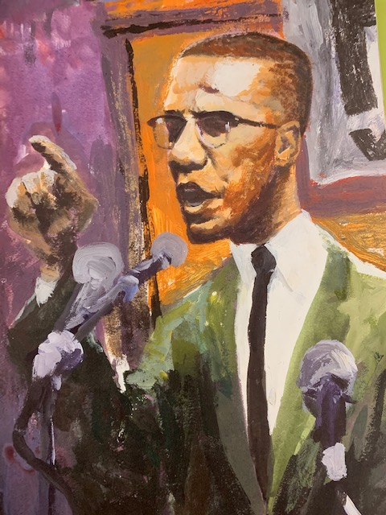
Notes:
2 minutes
Let’s see what this looks like in my classroom.
This is an image from a book I read to my students.
What do you see?
Who might this be?
What questions do you have?

Slide 6
“The Book Itch” by Vaunda Micheaux Nelson
Notes:
Put on your student hat again. This time you’re a student in your class. Lots of hats today!
5 minutes to read the book.

Slide 7
Writing a caption
Answer the following questions:
Who/what? . . . . . . . . . . . .
(did) what? . . . . . . . . . . . . . . .
When? . . . . . . . . . . .
Why? . . . . . . . . . . . . . . . . .
Sentence _________________________________________________
Notes:
3 minutes to complete worksheet.
The authors note that when students are brainstorming their ideas to use dots for the lines, not a solid line. Reserve the solid line for complete thoughts and sentences.

Slide 8
Sentence Kernels
Expand the following sentence using question words:
He spoke.
Who? . . . . . . . .
When? . . . . . . . . . . .
Where? . . . . . . . . . . . . .
Why? . . . . . . . . .
Sentence: ___________________________________________________
Notes:
3 minutes.
Another strategy is to write a simple sentence for students to then expand using details they learned from the text.

Slide 9
Providing extra support or intensification
Provide a word bank
Use more/fewer question words
Assign groups one “wh” question each and come together to write the caption/sentence
Teach complex sentence structures (dependent and independent clauses)
Reinforce point of view
Notes:
4 minutes
If this seems too easy or too hard, these are a few ways you can scaffold or intensify the instruction for your students.
I’ve posted student work around the room. Several are from third grade and some are from first grade. This strategy is accessible and valuable to the younger students!

Slide 10
Work time
Choose a book – read and enjoy!
Choose an illustration. Decide on either a sentence kernel or caption-writing activity. Will you need a word bank?
Create anticipated student responses – what do you want your students to know when they are finished with this activity?
Notes:
30-ish minutes

Slide 11
Reflection and prizes
Please feel free to contact me with questions or suggestions.
Lisa Larson
lmlarson@washoeschools.net

Slide 12
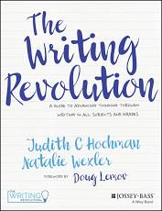
References
Hochman & Wexler (2017). The Writing Revolution. Jossey-Bass, San Francisco, CA.

