Slide 1
The Railroad “Sparks” the Rail City
Stacy Drum and Marcia Motter February 3, 2018

Slide 2
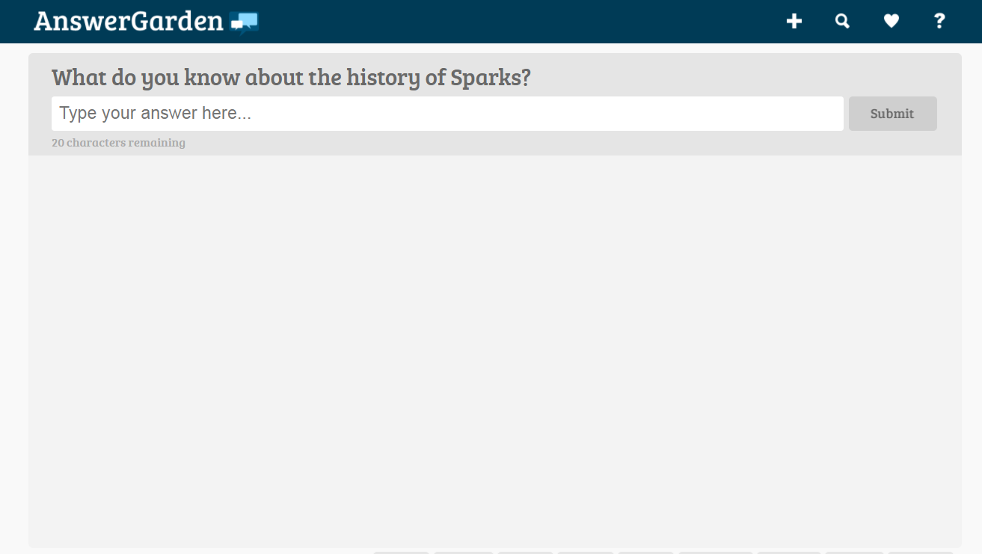
Welcome!
As you come in to this session, log in to https://answergarden.ch/633345 (or you can scan the QR code)
Answer the question, “What do you know about the history of Sparks?” using only verbs and/or nouns Ex.: “city nevada”, not, “It’s a city in Nevada.”
Fill out your name on the slip of paper.
Notes:
5 minutes
Stacy will find technology component for teacher to log in and answer question,
“What do you know about the history of Sparks?

Slide 3
Introductions:
Stacy Drum: K-6 Literacy Coordinator, WCSD
Marcia Motter-Johnson: 8th Grade History, Archie Clayton Pre-AP Academy
Notes:
3 minutes

Slide 4
Let’s see what we know about the history of sparks!
https://answergarden.ch/633345

Slide 5
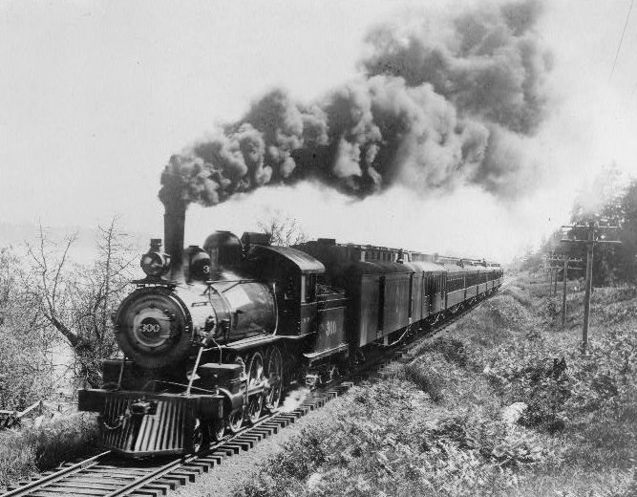
Compelling Question:
How did transportation and resources converge to create a new city?

Slide 6
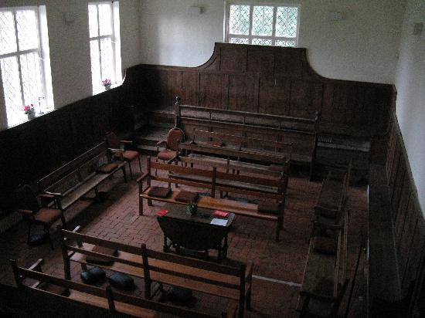
Sparks History
Quaker Reading –
Underline sentences in
your reading that you would
like to share
Be ready to read your choice of a sentence
Notes:
10- 15 minutes
Stacy Drum
Quaker Meeting What is a Quaker Reading?
Why is a Quaker reading important? Short and purposeful Sets up rest of activities

Slide 7
Resource #1
What is the purpose for this source? Who is the intended audience?
Review the resource silently for about 60 seconds.
Talk Task: Conductor and Trainman
Partner A reads the question out loud.
Partner B answers the question with evidence from the text.
Partner A agrees or disagrees with Partner B, explaining why.
Notes:
After participants have completed activity, we will take a few moments to adjust for different grade levels. Conductor is in charge and oversees the Trainmen. Trainmen report to the conductor
Possible suggestions:
TACOS APARTY Ask more questions to get into document
1 source a day using historical thinking skills

Slide 8
Resource #2a
Why did they dismantle and move the houses from Wadsworth instead of building new houses in Sparks?
Review the resource silently for about 60 seconds.
Talk Task: Conductor and Trainman
Partner B reads the question out loud.
Partner A answers the question with evidence from the text.
Partner B agrees or disagrees with Partner A, explaining why.
Notes:
After participants have completed activity, we will take a few moments to adjust for different grade levels.
Possible suggestions:
TACOS APARTY Ask more questions to get into document
1 source a day using historical thinking skills

Slide 9
Resource #2b
What additional information does this resource give you? Did you change your thinking about the previous source?
Review the resource silently for about 60 seconds.
Talk Task: Conductor and Trainman
Partner A reads the question out loud.
Partner B answers the question with evidence from the text.
Partner A agrees or disagrees with Partner B, explaining why.
Notes:
After participants have completed activity, we will take a few moments to adjust for different grade levels.
Possible suggestions:
TACOS APARTY Ask more questions to get into document
1 source a day using historical thinking skills

Slide 10
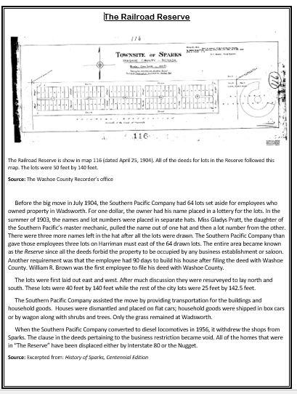
Resource #3
Why are the houses for the workers so close to the roundhouse? What was unique about this housing development?
Review the resource silently for about 60 seconds.
Talk Task: Conductor and Trainman
Partner B reads the question out loud.
Partner A answers the question with evidence from the text.
Partner B agrees or disagrees with Partner A, explaining why.
Notes:
After participants have completed activity, we will take a few moments to adjust for different grade levels.
Possible suggestions:
TACOS APARTY Ask more questions to get into document
1 source a day using historical thinking skills
Explain how the deeds can pair with secondary for more information

Slide 11
Resource #4a
What do you notice about this map? What do you notice about the street names?
Review the resource silently for about 60 seconds
Talk Task: Conductor and Trainman
Partner A reads the question out loud.
Partner B answers the question with evidence from the text.
Partner A agrees or disagrees with Partner B, explaining why.
Notes:
After participants have completed activity, we will take a few moments to adjust for different grade levels.
Possible suggestions:
TACOS APARTY Ask more questions to get into document
1 source a day using historical thinking skills

Slide 12
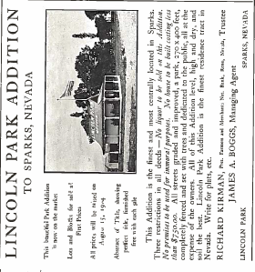
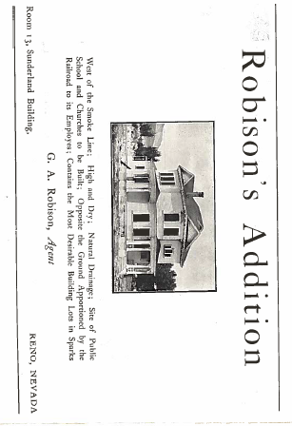
Resource #4b
How do these advertisements give you more information about the map? (4A)
Review the resource silently for about 60 seconds
Talk Task: Conductor and Trainman
Partner B reads the question out loud.
Partner A answers the question with evidence from the text.
Partner B agrees or disagrees with Partner A, explaining why.
Notes:
After participants have completed activity, we will take a few moments to adjust for different grade levels.
Possible suggestions:
TACOS APARTY Ask more questions to get into document
1 source a day using historical thinking skills

Slide 13
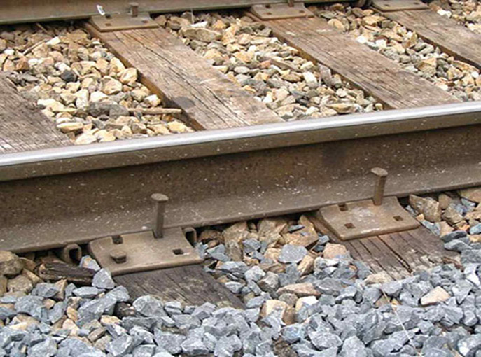
Lesson Closure
“Stake” a claim about the establishment of the city of Sparks.
Notes:
Work with their partner to write/say a claim about the establishment of the City of Sparks. Go back to the Answer Garden to see if we could add words.

Slide 14
Grade Level modifications
Sparks Nevada Free Historic Tours App
Notes:
Ask for participant ideas before we give ours.

Slide 15
sdrum@washoeschools.net
mmotter@washoeschools.net

