Slide 1
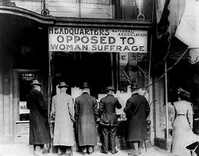
Empowering Women Voters: Celebrating the Centennial of Women’s Suffrage
Presenters: Patti Bernard, Sue Davis
Nevada Women’s History Project

Slide 2
Our Websites www.nevadawomen.org https://suffrage100nv.org/

Slide 3
The Project
Who are we?
What resources can we provide for Nevada educators?
When were we established?
Where can you access the information?

Slide 4
Resources on our Website
The Project
Research Center
Events
For Members
Suffrage
NWHP Store

Slide 5
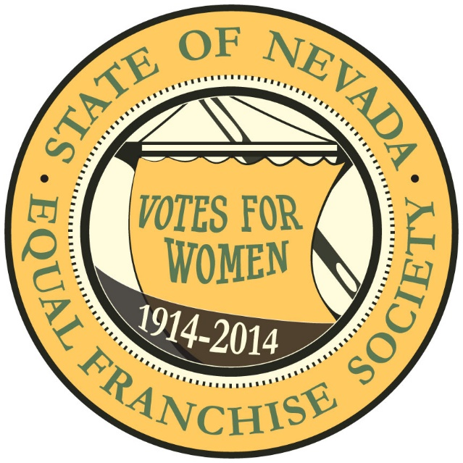
Nevada Suffrage Centennial
For the 2014 One Hundredth Anniversary of Nevada women gaining the right to vote, NWHP created the Nevada Suffrage Centennial website, with a grant from Nevada Humanities.
Suffrage100nv.org
Nevada Suffrage Timeline is in the “About” tab
The Vote is in the “About” tab
Suffragist Biographies

Slide 6
Suffragist or Suffragette
In 1912 Anne Martin explains the difference between the two terms:
“It is amusing to note the confusion existing about the use of the terms “Suffragist” and “Suffragette.”
“Suffragette” was coined five years ago in the sarcastic English Press to apply to the “rowdy,” “unwomanly” suffragists who had the courage to adopt militant methods in the face of continued trickery and deceit on the part of the government. All suffragettes are suffragists, but only the militant suffragists are suffragettes. I hope this is clear.”
“We western suffragists should not be called “suffragettes,” because we are non-militant.
Source: Equal Suffrage Notes, edited by Anne Martin for the Nevada Equal Franchise Society. Reno Evening Gazette, January 6, 1912, pg. 3.

Slide 7
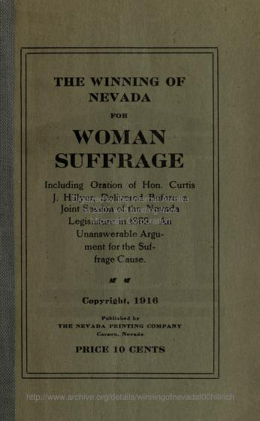
The First Attempt 1860-1894
Laura deForce Gordon came to Nevada 1867 to speak on spiritualism and the political rights of women
Storey Co. Assemblyman Curtis J. Hillyer gives the now famous oration “The Winning of Nevada for Woman Suffrage” to a joint session of the 1869 Nevada Legislature
Both houses of the Nevada Legislature PASS the suffrage resolution in 1869
The first Woman Suffrage Convention on July 4, 1870 in Battle Mountain, Nev.
The convention was organized by Senator M.S. Bonnifield. The first state suffrage organization was formed with Gordon, president; Bonnifield, recording secretary, and John I. Ginn, the editor of the Elko Independent, corresponding secretary.

Slide 8
The First Attempt 1860-1894
1871, only seven members who had been in the Assembly in 1869 returned, partly due to the transient mining population in Nevada at the time. Curtis Hillyer did not return.
Assembly passes the resolution 25 to 17
Senate did not pass the resolution 21 yea, 22 nay, 3 absent
Introductions of suffrage resolutions in 1873, 1881, 1883
Both house PASS the suffrage resolution in 1885, but it fails in 1887
Resolutions fail in 1889, 1891
No resolution introduced in 1893
1894 – Austin, Nev. forms the Lucy Stone Nonpartisan Equal Suffrage League with Fannie Weller as president

Slide 9
Suffrage Makes Great Gains 1895-1909
Susan B. Anthony and Dr. Anna Howard Shaw speak in Reno
Nevada State Equal Suffrage Association formed with Frances Williamson as president
1895 Legislature PASS a suffrage resolution in both houses
1896, suffrage organizations formed in Pioche, Panaca, Delamar and Ely
1897, Third annual meeting of the Nevada Equal Suffrage Association has 300 delegates from 13 counties
1897 the Senate passes the 1895 suffrage resolution, but it fails in the Assembly by 1 vote!
1899 Legislature fails to pass a suffrage resolution
Five Legislative session do not introduce suffrage, 1901-1909

Slide 10
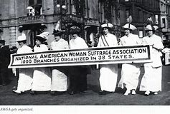
Suffrage Wins 1909-1912
1909, Mrs. Clarence Mackay, daughter-in-law of the John Mackay, and president of the New York Equal Suffrage Association, asks Jeanne Weir to start a Nevada suffrage organization
1911, The Nevada Equal Franchise Society is organized with Margaret Stanislawsky as president.
Felice Cohn, Carson City attorney, drafts a suffrage resolution which PASSES both houses in the Legislature
1912, Margaret Stanislawsky moves to California and Anne Henrietta Martin becomes president of the Nevada Equal Franchise Society
Many Nevada suffragists are also members of the Women’s Christian Temperance Union

Slide 11
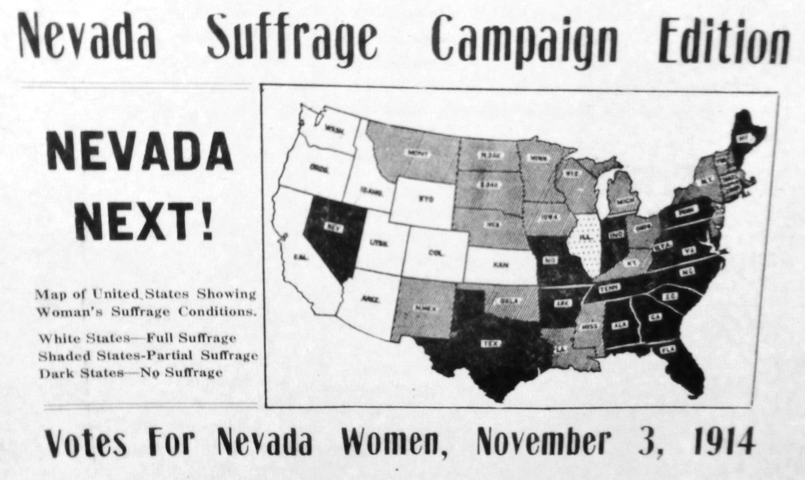

Slide 12
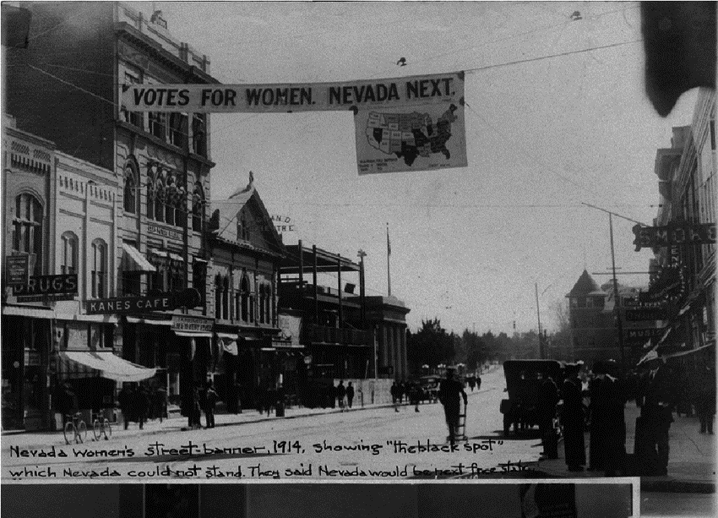

Slide 13
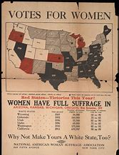

Slide 14
Suffrage Wins 1912-1913
1912, Bird Wilson, Goldfield attorney, writes Women Under Nevada Laws which is successful at placing women rights in the public awareness
1913, the Nevada Legislature approves the 1911 suffrage resolution! It now goes to a vote of the male electors in November 1914
Nevada women orchestrate a suffrage campaign in rural counties knowing George Wingfield’s political machine will be anti-suffrage in the larger population areas
The Nevada Federation of Women’s Clubs and the Twentieth Century Club are very active in civic issues
The suffrage constitutional amendment passes in 12 of 16 counties to become law!
Suffrage fails in Eureka, Ormsby, Storey and Washoe counties

Slide 15
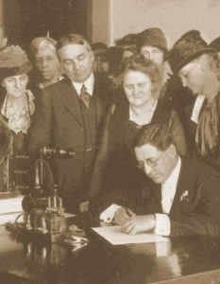
Nevada Women Gain Elected Positions- 1914-1918
Local suffrage organizations become civic leagues
Statewide voter training takes place
1915, Nevada women vote for the first time in city elections
1916, Nevada women vote for the first time in county and statewide elections
1918 – First Nevada woman elected to the Legislature, Sadie Dotson Hurst
May 21,1918 – Edna Baker of Sparks was the first Nevada woman elected to a statewide office in the Board of Regents
Anne Henrietta Martin ran as an Independent for a Nevada Senate seat in 1918 and 1920
Governor Emmett Boyle signs the resolution for ratification of the 19th Constitution, Feb 7, 1920. Assemblywoman Sadie Hurst is beside the Governor.

Slide 16
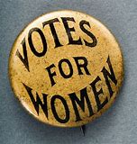
Federal Suffrage Amendment 1920
1848, Seneca Falls, New York, Convention becomes the centerpiece of the women’s rights movement
June 4, 1919, The U.S. Senate passes the 19th Amendment 56 to 25
There was no time limit set on the states to ratify the amendment, but it needed 36 states
Tennessee was the 36th state to ratify in 1920.
Nevada was the 28th state to ratify the amendment in 1914

Slide 17
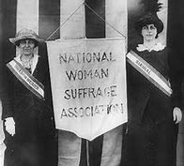
Federal Suffrage Amendment 1920
1920, Marjorie Brown, from Tonopah, Nev. travels to Hartford, Conn. to lobby Connecticut’s governor to call a special session to ratify the 19th Amendment.
Anne Martin returned to Washington, DC as a member of the executive committee of the National American Women Suffrage Association
Mabel Vernon drove Anne Martin around Nevada during Martin’s bid for a Nevada Senate seat. Vernon was from Washington, DC and an officer of the Congressional Union for Woman Suffrage

Slide 18
Nevada Women's Suffrage Website dedicated to the 100th Anniversary of Suffrage in Nevada: November 4, 2014
Topics
What did the Suffrage movement do?
Who were Nevada suffragists?

Slide 19
Our Website www.nevadawomen.org

Slide 20
Connecting to Educators
Website contains resources to help teach Nevada History
Lesson Plans (To be added to webpage)
4th Grade Lesson: Nevada Suffrage: What took so long? Developed by Jannele Mousel
7th Grade Lesson: Developed by Marcia Motter

Slide 21
Research Center
Nevada’s First Ladies
Biographies
Media Center
Interviews
Letters from Nevada’s Daughters
Informative Links

Slide 22
Letters from Nevada’s Daughters
Purpose
Letters from Nevada’s Daughters is a project for Nevada women to preserve and share their family and life histories.
The project was inspired by former Congresswoman Barbara Vucanovich.

Slide 23
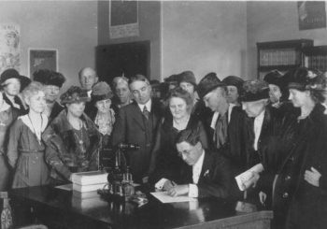
NEW: Legacy Page Nevada Women's History Project invites you to leave a legacy. Made Possible by The Terry Lee Wells Foundation
Create a webpage dedicated to a special Nevadan for only $25. Proceeds help support the NWHP and it's mission.

Slide 24
Nevada Women’s Suffrage Celebration
The Nevada Women’s Suffrage Celebration Committee was formed under the auspices of the Nevada Commission for Women to help facilitate collaboration among organizations in Nevada that will be celebrating and commemorating the 100th Anniversary of the 19th Amendment. The Committee will work to educate Nevadans on the suffrage movement and the historic importance of the ratification of the 19th Amendment.

Slide 25
Souvenir Suffrage License Plate
Purchase from Department of Motor Vehicles in person or on their website https://dmvnv.com
The charitable contribution of $25 for initial issuance and $20 for renewal will help fund the Nevada Commission for Women

Slide 26
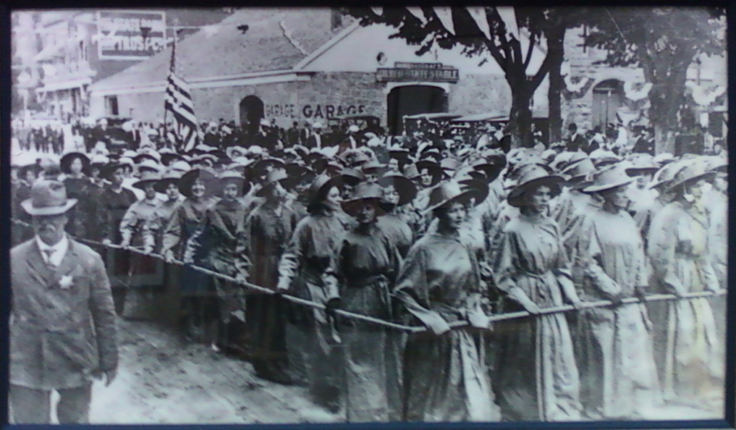
March as Living Flag Nevada Day 2020
The Nevada Women’s History Project is re-enacting this 1915 Living Flag for the 2020 Nevada Day Parade.
We would love to have you march with us. We need 150 women to say “yes” to be a part of this parade. You must be able to walk 2 miles on a level paved surface. The garments you will wear will be provided at the parade, there may be a modest cost to cover the garments.
Here is what we need you to do.
Sign-up on this website https://www.nevadawomen.org/events/make-your-place-in-nevadas-history/

Slide 27
Explore Nevada Women's History Project Websites www.nevadawomen.org https://suffrage100nv.org/

