Slide 1
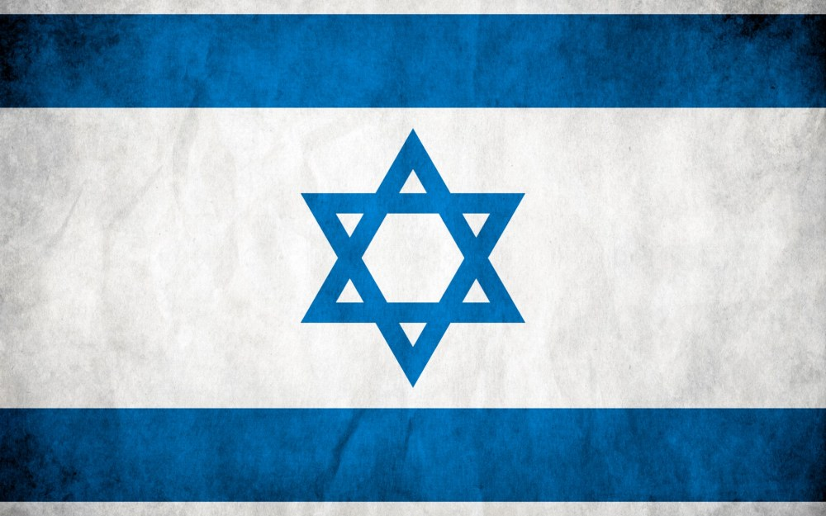
“Creating The State of Israel”
Creating the State Of Israel:
“OUTing” the World Geography Narrative
Mario Fitzpatrick
and
Katie Anderson

Slide 2
What is an OUT?
“OPENING UP the TEXTBOOK”
Developed by Stanford History Education Group as a way for students to discover historical accounts that go beyond the simplistic accounts of their textbooks
They are essentially DBQ’s that begin with a brief and insufficient section of the textbook.
Includes a writing task assessment at the end.
https://www.youtube.com/watch?v=6v1N7N1jKlk

Slide 4
OUTs address Core Actions 1-3
CA1: Focus each lesson on a high quality text/s.
Majority of lesson spent on reading, speaking, listening, writing about texts;
Texts are at or above grade level;
Texts… provide useful information, are illustrated.
CA2: Employ questions and tasks that are text dependent and text specific.
Questions attend to structure, ideas, events and details of text;
Students are required to use details to demonstrate understanding and support their ideas;
Questions address academic language;
Questions are sequenced to guide students into a deeper understanding of lesson objectives.
CA3: Provide all students with opportunities to engage in the work of the lesson.
Teacher uses strategies to keep all students persevering with challenging text;
Teacher creates conditions for student conversations;
Teacher acts on knowledge of individual students to promote progress toward independence and grade-level literacy tasks.

Slide 5
Disclaimer: We understand that…
…the Creation of the State of Israel is one of, if not the, most hotly contested geopolitical issues of the modern age.
…this is an issue that is shaped and driven by a plethora of historical and religious strata and by the perspectives of multiple groups both within and outside of the region.
…that there are two solid defendable positions and that people who care about this issue are usually bias towards the Israeli or the Palestinian cause.
We have, however, attempted to create a balanced presentation the factors contributing to this historic decision.

Slide 6
Why are we OUTing the Creation of the State of Israel?
The creation of the Israeli State in 1948 was predicated upon an Jewish religious tradition and Zionism, as well as political commitments made by colonial powers in the early 20th Century and finally because of the consequences the anti-Semitism, Nazi Germany and the Holocaust.
Since its creation, the Nation of Israel is has been under fire from amongst others, bordering nations and even some within America. It has also been seen as controversial and tumultuous and has shaped America’s relations in the Middle East.
Understanding its creation, is important for students to understand contemporary international relations, the political geography of the middle east and the ongoing conflict between Israel and Palestinians.

Slide 7
And… this is how your textbook explains it…
At the end of World War II, thousands of Jewish survivors of the Holocaust wanted to settle in Palestine. Palestine was considered the Jewish homeland. World opinion supported the establishment of a Jewish nation-state. Britain eventually referred the question of a Jewish homeland to the United Nations. In 1947, the United Nations developed a plan to divide Palestine into two states—one or Arabs and one for Jews.
Arabs in the region did not agree with division. However, the nation of Israel was established on May 14, 1948. Immediately, the surrounding Arab nations of Egypt, Syria, Lebanon, Jordan, Iraq, Saudi Arabia and Yemen invaded Israel to prevent the establishment of the state. Jewish troops fought back. By the 1950s, Israel was a firmly established nation. The 1948 war was the beginning of hostilities that continue to this day.

Slide 8
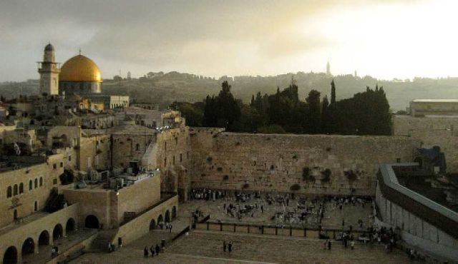
This OUT…. Complicates and Vivifies the text book account…
Essential Understanding:
How do the sources provided in the OUT complicate and vivify your understanding of the creation of the state of Israel in light of the Jewish historical claim to a homeland in Palestine?

Slide 9
And Unfolding Story: Ordering the Sources
Text Book
Biblical Narrative
Map: Biblical Boundary of Greater Israel
Overview of Zionism
Balfour Declaration and the subsequent White Paper
United Nations vote declaring Israel a State.
Map: Population Distribution of Palestine 1945
Map: Shifting Land Ownership 1945- 2005
Time to work through documents

Slide 10
Informational Writing Task
RAFT Structure
Role of writer:
An expert on the subject
Audience:
A person who knows nothing that is travelling to Israel
Format:
A “White Paper”
Task:
Explain the historical factors leading to the creation of the state of Israel

Slide 11
Mario Fitzpatrick: mfitzpatrick@washoeschools.net
Katie Anderson: KMAnderson@washoeschools.net

