Slide 1
Interdisciplinary learning for a changing planet
Sue Gonyou
Population Connection Trainer
TOSA for Washoe Country School District

Slide 2
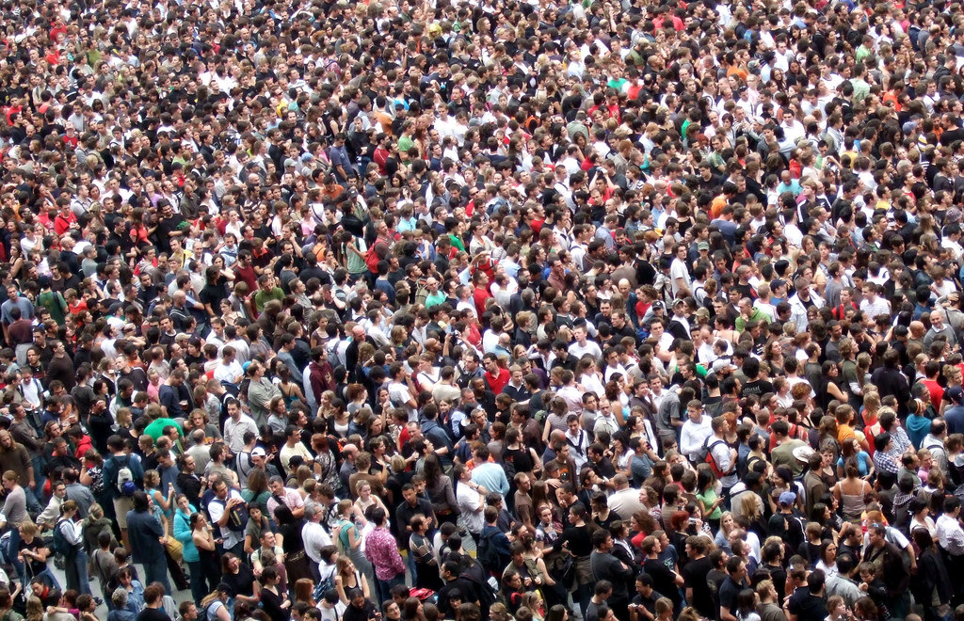
a new Hong Kong Add Germany 80 million 327.3 million 1.352 + 1.386 = 2.738 billion 7.6 billion
Why is population such an important consideration?

Slide 3
Today’s agenda
Population growth
Groups (elementary:1-3 and secondary:6-12)
Discussion of tasks
Degree of impact
Standards
Evaluation and sign in cards (CDs)

Slide 4
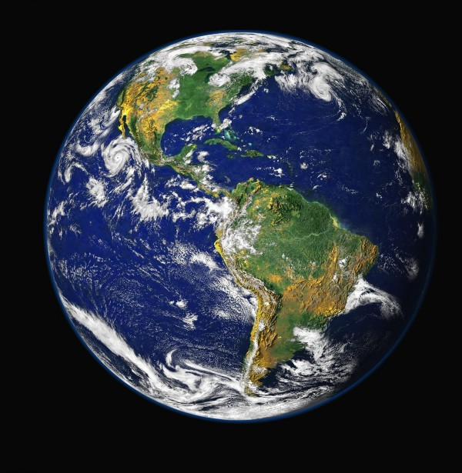
Population growth
Watch human population grow from 1 CE to present and see projected growth in under six minutes. This "dot" video, one of Population Education’s most popular teaching tools, was updated in 2015 and is now more accurate than ever. (Population Circles, as part of Oh How We Have Grown, show this as well!)

Slide 5
Groups for exploration (Share out in 15 minutes)
Elementary
Secondary
Earth: Apple of Our Eye
Global Cents (review)
(The Stork and the Grim Reaper)
(Create a budget for a US family; then read the story of the Phiri family from Malawi and develop their budget. How do they compare?)
Power of the pyramids
(Introduction and pyramid preparation)
A demographic tale of 3 countries
(Generate questions that your students could infer answers from viewing this display)

Slide 6
Degree of impact
Arrange yourselves in 6 groups, each with at least 2 but no more than 3 people. Mix grade levels if possible.
Read the degree of impact card and be prepared to share the following:
What is the category?
What is the issue?
How is it our problem?

Slide 7
Standards for 2018-2019
Grade 3 (blue)
Grade 8 (yellow)
How did our tasks today tie into your standards for next year?
Population topics: The numbers, agriculture, technology, carrying capacity, footprint, climate change, water scarcity, biodiversity, sustainability

Slide 8
Evaluation and closing
Population connection – awareness, training and changing behaviors – Asilomar and elsewhere
Folder contents – population connection opportunities and World population data sheet
Complete an evaluation
Complete a sign in card
Bring evaluation and sign in sheet to me – I will trade them for a CD with all of today’s activities

