Slide 1
Financial Literacy games
Denise Paxton & Sarah brown

Slide 2
Financial literacy is the ability to understand how money works in the world: how someone manages to earn or make it, how that person manages it, how he/she invests it (turn it into more) and how that person donates it to help others.
(How Money Works, PBS.org)

Slide 5
Budget puzzle
Middle School Alignment
High School Alignment
SS.6-8.FL.1. Prioritize and evaluate personal finance goals based on needs and wants.
SS.6-8.FL.2. Investigate consequences of potential financial decisions to make reasoned financial choices.
SS.6-8.FL.4. Discuss the components of a personal budget - including income, planned spending, expenses, and saving.
SS.9-12.FL.1. Analyze the alternatives and consequences of financial decision-making in the development of financial goals.
SS.9-12.FL.4. Develop and evaluate a personal financial plan - including a savings plan, utilizing a financial record keeping system for accounts.

Slide 6
Budget Puzzle
Hook – Goal Setting, Budget vocabulary
Each pair “earns” $2500 net income & must decide how to spend their income (budget cards)
Closure questions & Budget adjustments
“Exit Ticket” – Budget Reality Check worksheet & Budget Acrostic
Budge Guru sheet could be a more formal assessment
How to spend a hypothetical income
45-60 minutes
Pairs of students – 1 set of game materials for each pair

Slide 7
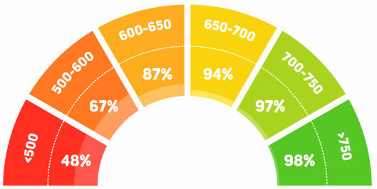
Credit Score Game
Middle school Alignment
High school Alignment
SS.6-8.FL.6. Explain an individual’s rights and responsibilities as a consumer.
SS.6-8.FL.7. Discuss the cost of borrowing money for different types of goods and services, including but not limited to: consumables, vehicles, higher education, and housing.
SS.9-12.FL.5. Analyze the costs and benefits of different types of credit and debt - including how to avoid and resolve debt problems.
SS.9-12.FL.6. Explain the purpose of a credit report, how that report is used by lenders, employers and insurers, and the borrower’s access, rights, and responsibilities related to a credit report.

Slide 8
Credit Score Game
The importance of credit scores and the factors that affect one’s credit score
45-60 minutes
Pairs – 1 game set for each pair, 1 Essential credit vocabulary to display, 1 debrief for each student
Hook – quickwrite & class discussion
Allow 10-15 minutes of game play – Draw impact cards and move your game piece based on the scenario and impact
Closure – complete the credist score debrief in pairs & discuss
Extension – Next Gen Personal finance activity

Slide 9
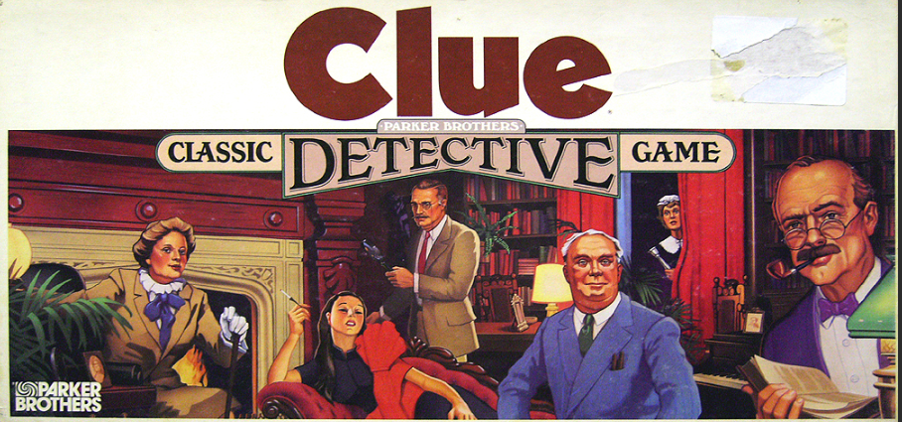
Get a Clue!
Middle School Alignment
High School Alignment
?
SS.9-12.FL.1. Analyze the alternatives and consequences of financial decision-making in the development of financial goals
SS.9-12.FL.9. Distinguish the cost and benefits of various investment strategies - including securities, stocks, and bonds; with attention to compound interest, risk, and methods of buying and selling investments.
SS.6-8.FL.2. Investigate consequences of potential financial decisions to make reasoned financial choices.
SS.6-8.FL.9. Explain how some investments differ from traditional savings accounts in potential risks and returns.

Slide 10
Get a Clue!
Hook – Quickwrite & Vocabulary review
Students play to answer – Who made the investment? What financial asset did he or she buy? How was the asset purchased? (place these 3 cards in the portfolio envelop)
Deal the cards & begin play – mark off on your detective notebook sheet
Closure – “Get a Clue debrief” worksheet & pairs discussion
Review financial assets and investment accounts
60-90 minutes
Groups of 4-6 students – 1 game set for each group, 1 “Detective notebook” & debrief sheet for each student

Slide 11
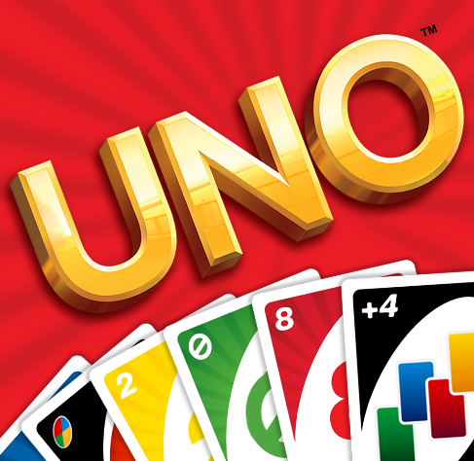
Occupational uno
Middle school Alignment
High school Alignment
SS.6-8.FL.2. Investigate consequences of potential financial decisions to make reasoned financial choices.
SS.6-8.FL.10. Identify college and career options and their effect on income and unemployment.
SS.9-12.FL.1. Analyze the alternatives and consequences of financial decision-making in the development of financial goals.
SS.9-12.FL.11. Evaluate college and career choices and their effect on income, disposable income, unemployment, and underemployment

Slide 12
Occupational uno
Learn about median wages & education requirements of common occupations
60 minutes
Groups of 4-5 students – 1 game set for each group & one Debriefing occupation uno worksheet for each student
Hook – Discussion prompt & discussion of key vocabulary
Allow 15 minutes of game play using the decoding sheet
Closure – Complete the Debrief sheet in groups and create collaborative responses
Optional extension activities

Slide 13
Insurance Vocabulary match
Middle School Alignment
High school Alignment
SS.9-12.FL.10. Analyze the purpose and specifics of various insurance plans as well as compare quality of insurance providers

Slide 14
Insurance Vocabulary match
Learn the basics of insurance
30 minutes
Pairs of students – 1 set of game cards for each pair, 1 Personal assessment & Vocabulary debrief for each students
Hook – Quickwrite & Personal Risk Assessment sheet
Allow 10-15 minutes of game play
Complete the vocabulary debrief in pairs and discuss
Extension lesson – “is insurance worth buying?”

Slide 15
Where do you find the games?
Http://bit.ly/PFgames
MKIRTS@EMAIL.ARIZONA.EDU

