Slide 1
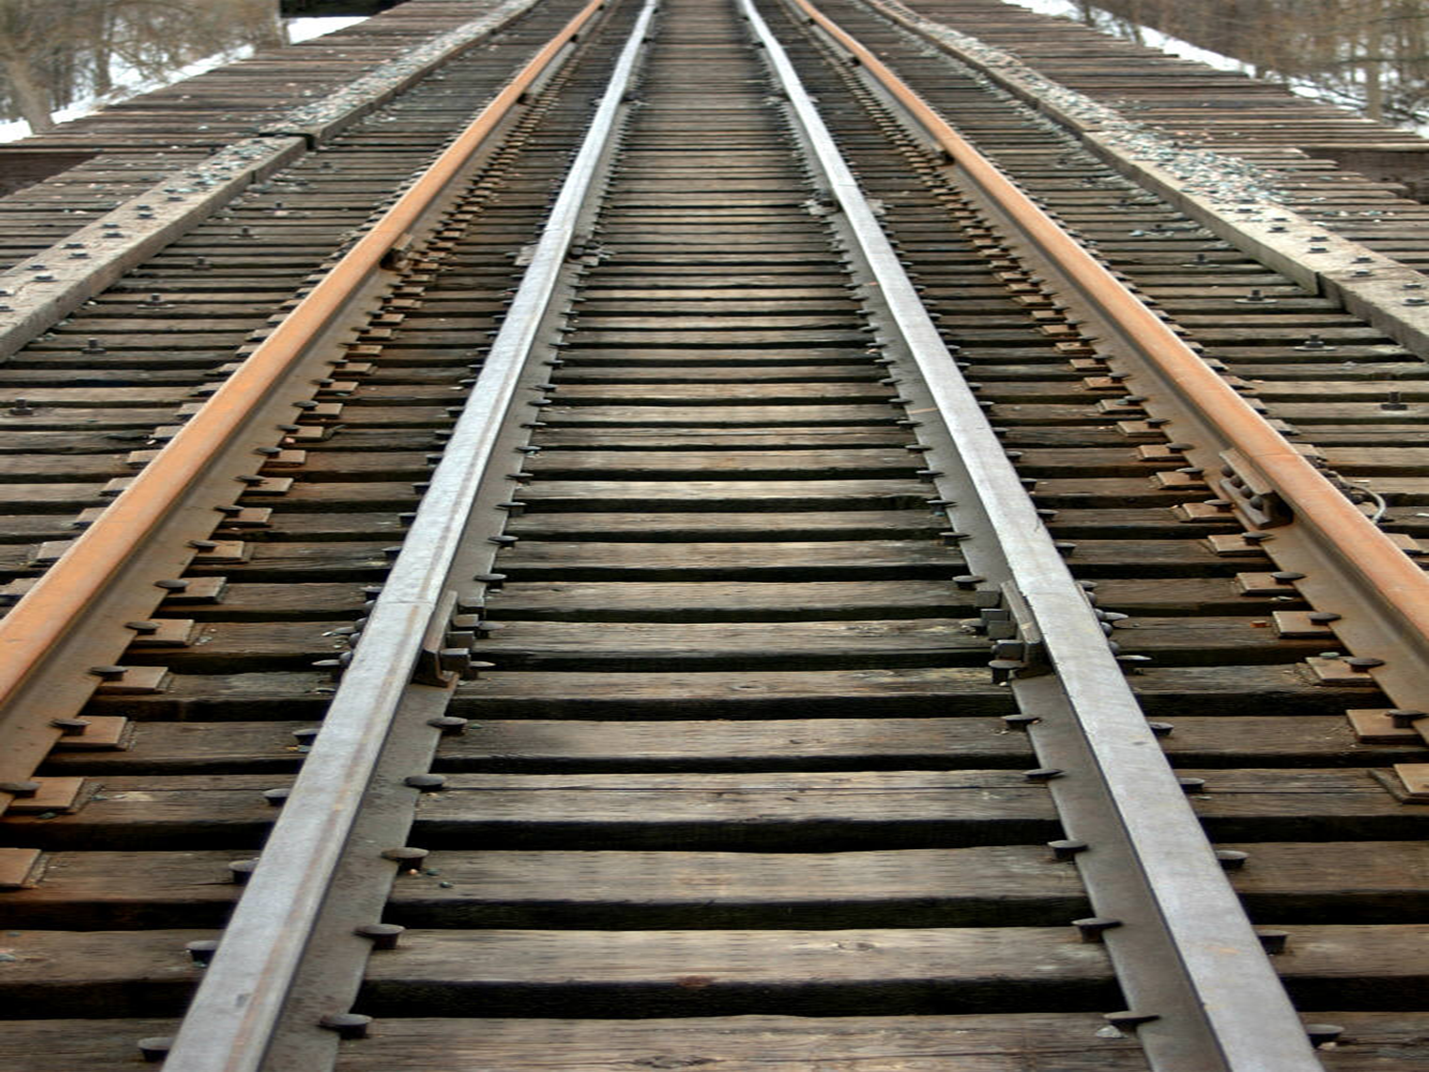
American Expansion Review Activity
-Get into groups of 3 or 4 (this will be specified)
-individuals not in a group and groups that do not meet the specified requirement will lose 10 points per person
-arrange the desks so you are all facing each other
-decide the following roles:
Artist
Scribe (writer)
Researcher
You may have more than one person for each role, but you must have all roles assigned.
You have two minutes to do this.

Slide 2
American Expansion Review Activity
-Send your researcher to get a sheet of paper from the back of the classroom.
PLEASE KEEP THE STACK NEAT!
-Your scribe writes down the first and last names of everyone in your group on the bottom right-hand corner on the BACK of the sheet.
-Your artist draws an outline of the US in the middle of the paper. Make your drawing big enough to work on, but small enough to include information and other art around the borders. Don’t agonize about the nooks and crannies.
-Your researcher gets markers and colored pencils – at least five colors
-You have FIVE minutes.

Slide 3
American Expansion Review Activity
-Now it’s up to you to decide who does which assigned activity. You have 10 minutes.
On the bottom left hand side of your map page, draw an outline of both American continents.
Include a legend/key explaining which explorers/colonizers went and claimed which locations and why:
a. The Spanish
b. The French
c. The English
On the US map, draw in the 13 colonies and label them.
Identify which are the Northern/New England, Middle, and Southern colonies.

Slide 4
American Expansion Review Activity
-Within each colonial region, identify the types of economic activities that happened. DRAW these activities within the region, and create a legend.
-Establish a clear boundary along the Appalachians.
-You have 5 minutes.

Slide 5
American Expansion Review Activity
-In the middle bottom margin of your map, create a timeline of these Revolutionary Events (you will need to put them in order):
Sugar Act
Declaration of Independence
Battle of Trenton
Boston Tea Party
Boston Massacre
Surrender at Yorktown
-Define each event
-Draw a representation of each event.
-You have 15 minutes.

Slide 6
American Expansion Review Activity
--On the bottom right hand side, compare/contrast the structure of the US government under the Articles of Confederation and the Constitution.
-You have 10 minutes.

Slide 7
American Expansion Review Activity
-Outline the area acquired in the 1783 Treaty of Paris and draw and label the states.
-Outline the area acquired in the 1803 Louisiana Purchase and draw and label the states.
-In the right middle margin of your map, describe the Louis and Clark expedition.
-You have 10 minutes.

Slide 8
American Expansion Review Activity
-Shade in the area affected by the Industrial Revolution.
-Off to the right of this area, describe how the Industrial Revolution begins.
-Draw in and label the Erie Canal and the National Road.
-You have 10 minutes.

Slide 9
American Expansion Review Activity
-Shade in and label the area acquired in the Adams-Onis treaty.
-Provide a definition of the treaty next to the area affected.
-You have 5 minutes.

Slide 10
American Expansion Review Activity
-Shade in and label the area affected by the Monroe Doctrine.
-Provide a definition of the doctrine.
-Provide a visual representation of the doctrine next to the area affected.
-You have 5 minutes.

Slide 11
American Expansion Review Activity
-Draw the border across the country that reflects the Missouri Compromise line
-write a definition of the Missouri Compromise along the border.
-Create a visual representation within the state of Missouri of the compromise.
-You have 5 minutes.

Slide 12
American Expansion Review Activity
-To the right of the top middle margin, define the “Spoils
system” and create a visual representation of it.
-You have 5 minutes.

Slide 13
American Expansion Review Activity
-Identify the path taken on the Trail of Tears.
-write a definition that includes both the Trail of Tears and the Indian Removal Act and create a visual representation of either or both of these where the trail ended.
-You have 5 minutes.

Slide 14
American Expansion Review Activity
-Circle the area where “revivals” took place, and identify it as such.
-you have one minute.

Slide 15
American Expansion Review Activity
-In the top middle margin, define and provide a visual representation of:
-The Cult of Domesticity
-The Temperance Movement
-you have five minutes.

Slide 16
American Expansion Review Activity
-Recreate the earliest telegraph lines, in the area(s) where they appeared, with a visual representation of a telegraph line.
-you have one minute.

Slide 17
American Expansion Review Activity
-Draw five railroads, in the area(s) they first appeared. Only one may be in the South.
-you have two minutes.

Slide 18
American Expansion Review Activity
-Indicate the area(s) affected by Manifest Destiny with a large visual representation covering this area. To the left of the area affected, write a definition of Manifest Destiny.
-you have three minutes.

Slide 19
American Expansion Review Activity
-Draw the Santa Fe and Oregon Trails, with a visual representation of the reason for each trail along the route followed by the trail.
-you have three minutes.

Slide 20
American Expansion Review Activity
-Draw the border along the area represented by “Fifty Four Forty or Fight!”, and label the border.
-include a visual representation and definition of this issue just above the border.
-you have three minutes.

Slide 21
American Expansion Review Activity
-Within the state of Texas, create three visual representations:
Representing Mexico’s recruitment of American farmers
Representing the Texas Revolution
Representing the War with Mexico
Include a written explanation of these events (demonstrate your research!)
-you have five minutes.

Slide 22
American Expansion Review Activity
-Shade in and label the areas acquired and the borders established:
In the Texas Revolution
In the War with Mexico
In the Treaty of Guadalupe Hidalgo
In the Gadsden Purchase
You have two minutes

Slide 23
American Expansion Review Activity
-Identify the area affected by the 1849 Gold Rush
-draw a visual representation
You have two minutes

Slide 24
American Expansion Review Activity
Clean up
-Your scribe returns the markers and pencils to the proper box
-Your artist gives me your poster
-Your researcher rearranges the desks (with the help of everyone else when their tasks are complete)

