Slide 1
Text-Based Strategies to Boost comprehension
Sarah Brown, NWRPDP
sabrown@washoeschools.net

Slide 2
Vocabulary predicting
Identify the main concept/topic of the text and List the tier 2 academic vocabulary words from the text that you would like students to focus on.
Have students write a sentence for each word that connects it to the topic.
During and after the reading, ask students to correct (rewrite) their sentences and identify where in the text they found the information that helped them understand the word.
Notes:
Walk through

Slide 3
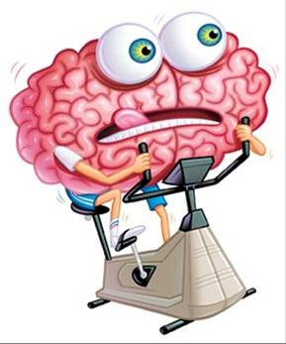
Active reading guide
Ask students to record predictions and questions after first reading through the title, headings, or topic sentences of a text.
As students read ask them to complete three of the sentence prompts.
After completing the reading, ask student to complete the summarizing and connecting portion.
How to line # your document…
Layout Tab
Line Numbers
Continuous
Suppress when necessary
Notes:
Do this strategy with the textbook reading

Slide 4
Mind’s eye: imaging & predicting
Select 20-30 words from the text
Read the words to the students as students create mental images.
Ask students to draw a picture, make predictions, and ask questions about the text based on the words.
After reading the text, have students compare their predictions with their initial ideas and summarize the main ideas/claims.
Notes:
Walk through

Slide 5
The gist
As students read the text they will record key words and phrases.
After reading, they will write a 20 word summary of the text.
Challenge students to use as many of their key words & phrases as possible (while still
making a coherent complete sentence! ☺)
Notes:
Do this strategy with “dog” article

Slide 6
Split-screen notes
Notes:
Walk through

