Slide 1
Cold War anxiety and Propaganda
In Art and Film

Slide 2
Bios
Brett Barry and Kylie Maddy both teach at Spanish Springs High School. Brett teaches AP Art History and Kylie teaches American History through Film. Together they also teach an in-service course called “Cinema and Art in the Social Studies Classroom” where they focus on helping teachers re-invent their lesson plans by introducing art and film clips.
Bbarry@washoeschools.net
Kylie.Maddy@washoeschools.net

Slide 3
Today’s Focus
In history classes we love to use primary and secondary texts to teach content and reinforce CCSS skills. However, we can also think of art and film in the same way we think about text when it comes to complexity, relevance to history, and its ability to teach both content and skills.
Art and film also does something that text sometimes cannot, it offers a unique cultural perspective on a moment in time in history. Art and film is made with a message and audience in mind and often times strives for mass appeal and consumption. Therefore, art and film can provide the perspective that textbooks and traditional texts often ignore.
Today we are focusing on using Cold War era art and film to examine American and Soviet perspectives and also show you how to transform CCSS strategies through the use of art an film.

Slide 4
Reading Strategy: QCQ (Questions, Comments, Quotes)
QCQ is an easy way to get your students to read a text deeply and also offers a great base for small groups discussions.
Read the article Science Fiction Films and Cold War Anxiety and fill out the organizer with one question, one comment, and one quote.
A QCQ is great for text but can also be used to analyze film clips. Instead of quotes, students should be allowed to paraphrase as quoting directly and precisely from films can be challenging.
Furthermore when using a variety of film clips it works best to have a guiding claim or prompt that gives the students direction when completing the QCQ. For our purposes I want you to focus on this claim…
Science fiction films of the 1950s showcased Cold War anxieties.

Slide 5
The Day the Earth Stood Still (1951)

Slide 6
Invasion of the Body Snatchers (1956)

Slide 7
Them (1954)

Slide 8
Murder Mystery Museum Walk
First and foremost this lesson is designed with the intention to have FUN.
It is also a way to enrich your existing lesson plans, differentiate your classroom, and create critical thinking skills with powerful images from moments throughout history.
Adding art to an existing unit by going to Smart History Website https://www.khanacademy.org/humanities/art-history-basics/beginners-art-history/a/cave-painting-contemporary-art-and-everything-in-between
Find a piece of art from a specific time period and cut it up to make a museum.
You can also grab # different pieces that speak to a specific contextual issue

Slide 9
Student Instructions
With your partners you will have the ORGANIZER
You have 2 minutes at each of the 8 of stations.
In these 2 minutes you will:
1. describe in detail what you see in the piece of art.
2. start writing the introduction to a Murder Mystery Novel using the visual image at that station. “It was a dark and sultry night when the murder occurred…” Your story must be driven by the visuals you see.
3. continue this as your work through the stations. Be sure to build on your story with each new bit of evidence. Your story should progress.
4. by the end of the rotations you will have the introduction to your story which you will to read to the class.
5. each person in the group will equally share the reading to the class.

Slide 11
Context
Russia had for centuries been an absolute monarchy ruled by a tsar, but between 1905 and 1922 the country underwent tremendous change, the result of two wars (World War I, 1914-18 and Civil War, 1917-22) and a series of uprisings that culminated in the October Revolution of 1917.
The Union of Socialist Soviet Republics (USSR) was established in 1922 under Vladimir Ilyich Lenin.
The young communist state was celebrated by many artists and intellectuals who saw an opportunity to end the corruption and extreme poverty that defined Russia for so long.

Slide 12
Context
This photomontage is an ode to the success of the First Five-Year Plan, an initiative started by Stalin in 1928.
The Plan was a list of strategic goals designed to grow the Soviet economy and accelerate its industrialization.
These goals included collective farming, creating a military and artillery industry and increasing steel production.
By the end of the First Five-Year Plan in 1933, the USSR had become a leading industrial power
In this work of art, Stepanova has also used the tools of the propagandist. This photomontage is an ideological image intended to help establish, through its visual evidence, the great success of the Plan.

Slide 13
Student Directions
On your organizer please use the details of the Stepanova image to answer the following two questions?
Question 1: How does this art reflect goals and ideals of the Soviet Union in the 1930s?
Question 2: What techniques are used in this piece to convey its message?

Slide 14
Constructing the image
The Russian avant-garde had experimented with new forms of art for decades and in the years after the Revolution, photomontage became a favorite technique of artists such as Varvara Stepanova.
She was a leading member of the Russian avant-garde and later in her career, she became well known for her contributions to the magazine USSR in Construction, a propagandist publication that focused on the industrialization of the Soviet Union under Joseph Stalin
In Stepanova’s photomontage, everything is carefully constructed. The artist uses only three types of color and tone. She alternates black and white with sepia photographs and integrates geometric planes of red to structure the composition.
On the left, Stepanova has inserted public address speakers on a platform with the number 5, symbolizing the Five Year Plan along with placards displaying the letters CCCP, the Russian initials for USSR.

Slide 15
Constructing the image
The cropped and oversized photograph of Lenin shows him speaking; his eyes turned to the left as if looking to the future. Lenin is linked to the speakers and letter placards at the left by the wires of an electrical transmission tower.
Below, a large crowd of people indicate the mass popularity of Stalin's political program and their desire to celebrate it.
Red, the color of the Soviet flag, was often used by Stepanova in her photomontages.
Several clear artistic oppositions are visible in The Results of the First Five-Year Plan. For example, there is a sharp contrast between the black and white photographs and the red elements, such as the electric tower, the number 5, and the triangle in the foreground.
Our eyes are attracted to these oppositions and by the contrast between the indistinct masses and the individual portrait of Lenin, as an implicit reference to the Soviet political system.

Slide 16
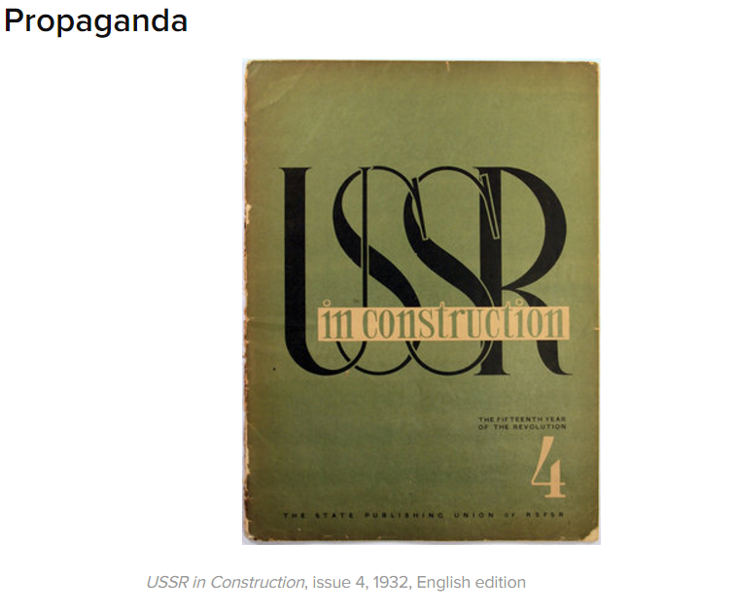
The public targeted by USSR in Construction was mostly foreign. The purpose of the magazine was to show countries such as France and Great Britain that the USSR was also a leading force in the global market and economy.
By choosing to include images rather than just articles, the public would be able to see with their own eyes the accomplishments achieved under Stalin. At first the subjects depicted were strictly industrial, but as the magazine gained recognition and readers, topics diversified, and included subjects from education to sports and leisure.

Slide 17
Links for Art/Film and Awesome Lessons
Smart History Website https://www.google.com/url?sa=t&rct=j&q=&esrc=s&source=web&cd=13&cad=rja&uact=8&ved=0ahUKEwiFqd6i8aTSAhVD52MKHXr0B5MQ-TAIfCgAMAw&url=http%3A%2F%2Fsmarthistory.org%2F&usg=AFQjCNEKlqsPNhVDKk5dnmFGYuyqkyH8ow
Project Tahoe https://www.google.com/url?sa=t&rct=j&q=&esrc=s&source=web&cd=1&cad=rja&uact=8&ved=0ahUKEwjpvr7R8aTSAhVP32MKHdm0AaMQFggaMAA&url=http%3A%2F%2Fprojecttahoe.org%2F&usg=AFQjCNH24t0xc1Y4QXrJhqTJuLFzHT3qQA&bvm=bv.147448319,d.cGc

Slide 19
