Slide 1
Using the Because But and So Sentence Expansion Activity February 3, 2018
Jessie Dean, SOSA
Kyley Quigley, SOSA
Aaron Grossman, 5th Grade Teacher at Roy Gomm
All Resources are posted at
www.Room360.org

Slide 2
NVAC Language Standards
Use frequently occurring conjunctions
Use a known root word as a clue to the meaning of an unknown word with the same root
Explain the function of conjunctions
Use coordinating and subordinating conjunctions
Use reflexive pronouns
1st Grade
2nd grade
5th grade
3rd grade
1st grade

Slide 3
Some Context
Peg Tyre, Author of the Good School
https://www.youtube.com/watch?v=zK30CtytG2k
Min: 0:00 to 3:47
Focus Questions:
What does it mean that writing can be caught, not taught?
How does your experience compare to what Peg Tyre outlines?

Slide 4
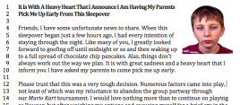
Because, But & So
To start, you need a text (here)

Slide 5
Reading the Text
Silently read the text
Stand
When you see someone else standing, read the text with that person
Return to your seat, identify the super claim
Underline the super claim

Slide 6
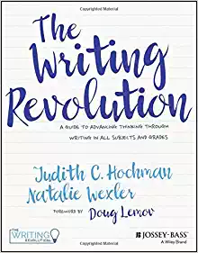
Because, But & So
Judith Hochman
Natalie Wexler
https://www.thewritingrevolution.org/

Slide 7
because -tells why
but -change of direction
so -cause and effect

Slide 8
Fragments
The boy needs to be picked up because,
The boy needs to be picked up early, but
The boy needs to be picked up early, so

Slide 9
Norms for Watching Video

Slide 10
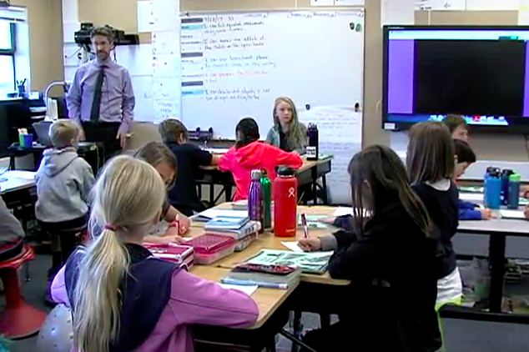
Lesson Demonstration
Because, But & So
https://www.youtube.com/watch?v=lbJ0kzjR9lo&t=19s
As you watch, consider how the language standards are integrated with the content

Slide 11
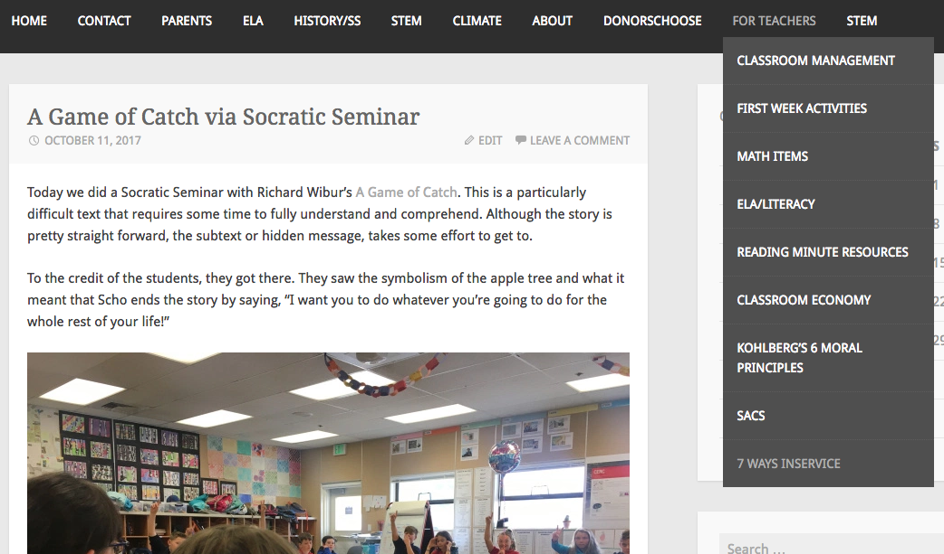
Thank You!
Materials at www.Room360.org
Contact agrossman@washoeschools.net

