Slide 1
The Urbanization Game
Modern Period 1750-1900
Notes:
Please check the Jamboree DVD for the Original Urbanization Game. This is a PPt version by Lesley Cordell and Gregg McDonald
Redmond High School/lcordell@lwsd.org/gmcdonald@lwsd.org/ The image key is the second half of the Power Point and .jpeg submission.
Note that it is in Vista format. It can be converted, but of course with backwards conversion it will lose some of its animations, etc.

Slide 2
To Begin
You will work in GROUPS OF 3-4.
You will use one large sheet of paper per group.
Each group will have a template showing the size and shape of each element to be added to their town.
Listen carefully to the story and work quickly as a group to add the required elements for each round.

Slide 3
Introduction – 1700 (3 minutes)
The year is 1700 and the nation is England. The scene is a rural village.
Draw a river across your paper connecting east to west; the river should be about 1 inch wide.
Draw a simple wooden bridge crossing the river;
Draw 2 roads one running north to south and crossing the river at the bridge and one running from east to west. Neither road need be a straight line.
Draw 10 houses; 1 church; 1 cemetery; 1 store; 1 pub; 1 coal mine; & at least 50 trees

Slide 4
Round 1 - 1745 (2 minutes)
England’s geography is unique in that no section of the country is more than 90 miles from the sea and there are many navigable rivers that crisscross the countryside.
An enterprising young capitalist (you) decides to invest money in the construction of a canal. This is not a public venture but rather a private one. The profits from your canal are astonishing! For example, one canal built in 1745, the Oxford Canal, yielded a 300% annual return for its investors for a period of more than 30 years.
This new revolution in transportation reduced the price of raw materials and reduced the cost of transportation drastically. Coal could now be transported from the mines to the towns for half the price of horse-wagon transportation.
Since you invested your money, thereby making a tidy profit, build yourself 1 nice home anywhere on the map you would like it to be.
Don’t forget to construct the canal. It must run parallel to the river.

Slide 5
Round 2 - 1750 (1 minute)
For a variety of different reasons (soap, diet, sanitation, etc…) there is a population explosion in England, and your village. The cursed Bubonic Plague which for centuries wiped out your village has been virtually eliminated due to improved sanitation systems.
Add 5 houses (total 15).

Slide 6
Round 3 - 1760 (1 minutes)
The people of your village need a bit more food and goods to meet the needs of the new inhabitants. Coincidentally, a number of other noteworthy events occur around 1760. First, a number of new mechanical inventions for farming are developed. Perhaps the greatest impact was Jethro Tull’s creation of the seed drill and the horse drawn cultivator.
Also, farmers begin to experiment with new, more productive farming practices like crop-rotation, new fertilizers, & new livestock breeding techniques. Consequently farm production is significantly increased. But there is one problem. Most farmers own one tract of land. Why should they, or how could they, invest in expensive machines when their land is so small? What’s more, it’s almost impossible to buy land from anyone!
At the same time, pressure is placed on Parliament by large and small landowning farmers to make more land available. Where is that land coming from? State-owned land called the “Commons”. A series of laws called the Enclosure Acts are passed by Parliament which allows landowners can buy pieces of common land from the government, but only wealthy landowners can afford to do this. Small farmers suffer further
Fence off an area 3x3 inches to be reserved as a commons.
Add 5 houses (total 20) and 1 more nice house.

Slide 7
Round 4 – 1773 (1 minute)
A man named Richard Arkwright invents a new machine that can spin and weave cloth a hundred times faster than could be done by hand in a farm cottage ( the most common way of producing cotton cloth up to this time): the cottage industry (putting-out system). He calls his new machine the Water Frame because its principle source of power was water.
Let’s imagine that the first water frame was built in your village (because of the river). Since the water frame was large, a special building was needed and thus, the first factory for producing cotton cloth was built.
Add 1 factory (no smoke—it is powered by water). Remember, the cotton factory must be placed on the river bank. Canal water is not swift enough to generate the power to the working parts of the water frame.
Add 5 houses for workers (total 25)

Slide 8
Round 5 – 1774 (1.5 minutes)
Workers are needed to work in this new factory. Since many people (women) cannot compete with the spinning and weaving of cloth made in the factory and there are large numbers of poor families who have lost their livelihood due to the Enclosure Acts and Highland Clearances, we do have an available supply of workers.
People move to your village to find work.
Add 15 houses (total 40); 1 church , 1 pub, & 1 store.
You may draw additional roads and 1 additional bridge.
http://www.uncp.edu/home/rwb/power_loom.jpg

Slide 9
Round 6 – 1776 (1.5 minutes)
The profits from the first textile factory are enormous. It should be no surprise that Richard Arkwright is referred to with two titles: The first millionaire and the father of the factory. New factories are built in your community:
The early owners of these factories called themselves capitalists because they had the capital or money to purchase the raw material, the building, the water frame, and to pay their workers a fixed wage and make a profit.
Add 5 new factories (must be on the river bank as they need water power).
Add 5 houses (total 45)

Slide 10
Round 7 – 1780 (1 minute)
Unemployed workers from surrounding areas flood into your community looking for work. Although wages are very low, they look attractive to starving families.
Housing is in great demand and for the first time a new kind of housing is constructed called tenements. Here dozens of families reside under one roof.
Add 5 Tenements.
http://www.assumption.edu/users/McClymer/bedfordprototype/toc/default2.htm

Slide 11
Round 8 - 1781 (1.5 minutes)
More workers need to live, eat, shop, drink, worship. We need the social support services to go along with the demand.
Add 1 store, 1 pub, 1 church, & 1 school for those families wealthy enough to send their children (boys) to school.
Since workers in the factories work 6 days a week, the only day of rest is Sunday. People flock to your churches, so make them convenient for their tired feet.
http://www.manchesteronline.co.uk/ewm/ic11/64.jpg

Slide 12
Round 9 – 1782 (1.5 minutes)
Workers work long, hard hours in the factories. The average work day begins at 6:00 a.m. and ends at 9:00 p.m. There is only a 30 minute break for lunch.
After work, exhausted, “stressed out” workers stop at their local pub for some relaxation. Alcohol begins to be consumed throughout England in record amounts, especially with the wider availability of “spirits” – aka hard liquor.
Add 5 more pubs.
Destroy 5 houses (total 40), add 4 tenements.

Slide 13
Round 10 - 1783 (1.5 minutes)
Workers barely eke out a marginal existence. There is never enough money to save and some workers go into debt. Few, if any, could afford to send their children to school.
Still, there are a few families whose lifestyle is quite comfortable, even luxurious. Who are they? They are the large landowning farmers and factory owners. Handsome manor houses are built and some are lavishly furnished with art. These new rich (nouveau riche) are not part of the aristocratic class of England but they now can enjoy some of the refinements of the aristocratic rich such as food, servants, furniture, education, fine clothing, carriages, etc….
Add 2 special homes.
Add 1 factory, add 15 houses for management personages (total 55) (Note: from this point on trees may be removed if you need space).
http://www.localhistory.scit.wlv.ac.uk/articles/bushbury/ahc38x.jpg

Slide 14
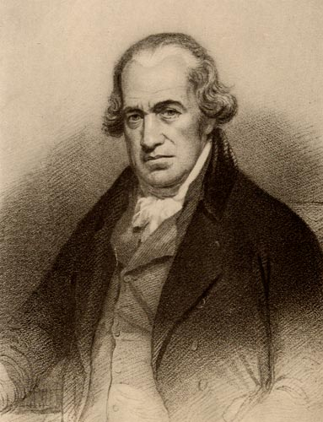
Round 11 - 1785 (1.5 minutes)
A man named James Watt perfects a new machine called the steam engine. The steam engine replaces the water frame.
First, it is far more efficient. Second, it allows factories to be built away from the river. This source of power is more mobile.
Capitalists quickly replace their water frames with steam powered weaving and spinning machines. The main business in England is still textile manufacturing.
Add 10 factories with smoke. Add smoke to all other pre-existing factories.
Also, add 1 nicer house since people continue to get rich.
Add 5 houses (total 60) and 1 tenement.
http://www.ironorchid.com/clipart/persons/images/Watt_J.jpg

Slide 15
Round 12 - 1800 (1 minute)
A man named Henry Cort has just invented the puddling process. This process makes it possible for coal, which is, fortunately, in abundant supply in England, to be used as the primary fuel in the new iron industry.
Consequently, your town is thrust into the “Iron Age”. Larger factory districts appear which manufacture iron at low prices and that can easily be transported by your canal.
Add 1 new coal mine and a new iron bridge to replace the old wooden one.
Add 5 houses (total 65).
http://www.davistownmuseum.org/BioPics/BessemerConverter.jpg

Slide 16
Round 13 - 1815 (1minute)
Coal miners are busy mining coal. There is a great demand for coal right now: home-heating, fuel for the steam engines, for the production of iron.
Although in the 1700s coal miners were adults who worked in the winter to supplement their wages, in the 1800s they are typically children between the ages of 8 and 14.
The work is dangerous and unhealthy. Children become victims of black lung, explosions, & accidents. Their growth is stunted as they spend their 14 hour day stooped over. They are malnourished and unable to exercise or eat properly.
Casualty rates go up.
Add another coal mine.
Draw 1 cemetery.
http://www.wolverhamptonhistory.org.uk/assets/userfiles/wolverhampton_history/industry/001505.jpg

Slide 17
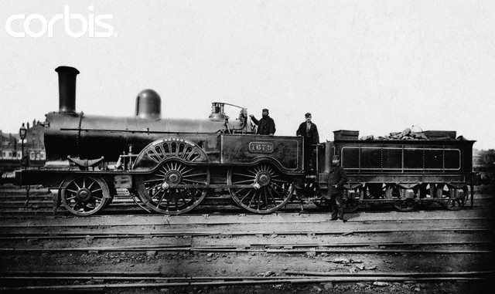
Round 14 - 1820 (1.5 minutes)
The existing canals and dirt roads cannot accommodate the heavy industrial traffic. New experiments with transportation using the power of a steam engine are tried. The most successful appears to be a steam engine that pulls a series of wagons or cars on an iron track. The first railroad is tested and proves to be quite effective.
Add 1 major railroad line connecting all your factories to your coal mines. This is one continuous track which must connect all factories and mines (you may build additional railroad bridges only as needed).
Add 5 houses (total 70) for railroad builders.
http://pro.corbis.com/images/HU021053.jpg?size=67&uid=%7B9308DE71-BD3D-4B42-BFBD-8F596EA17480%7D

Slide 18
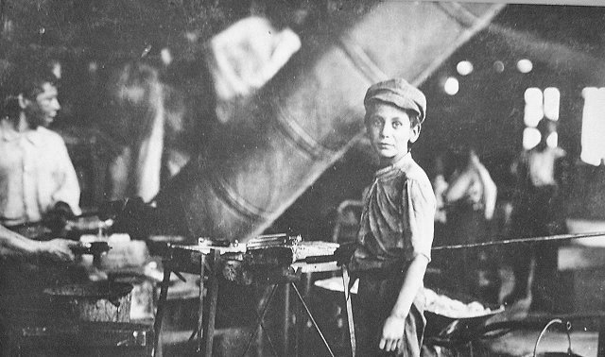
Round 15 - 1827 (1 minute)
This new “revolution” in transportation draws thousands of people to your community. Soon there becomes a surplus of workers. Capitalists who wish to ensure their profits decide to hire women and children over men because they can perform the same factory labor at one-half to one-quarter the price.
More and more children leave their homes to work. Depressed, ashamed, and angry about their wives, and children toiling in factories, many men turn to crime, and the social life of the pub. For the first time in England’s history, alcoholism appears in epidemic proportions. Family life that existed for hundreds of years in England is disrupted. Family members seldom eat together or see each other.
Add 1 jail
Add 2 pubs
Add 2 tenements
http://tdaait.files.wordpress.com/2008/07/child_labor_big.jpg

Slide 19
Round 16 - 1838 (1 minute)
Let’s look at the working conditions in the factories. The two predominant factories are textile and iron (steel). Working conditions in either of these two were appalling. Many workers contacted the deadly factory fever or white lung disease. It was probably a variety of lung ailments: cancer, tuberculosis, emphysema, etc…
Other workers were injured on the job in factory accidents. There were no protective railings around the huge moving mechanical parts of machinery.
Children, weakened from lack of proper sleep or diet, stumbled into machinery and were mutilated. Women with long hair that became undone often found themselves caught in moving machinery.
Regardless, if you were unable to work, you were fired. There was no health insurance. There was always a daily line of unemployed workers waiting to fill vacant jobs.
Add 2 hospitals and 1 more cemetery.
http://www.citiesofthedead.net/holt/durkee25_holtcemetery_1907a.jpg

Slide 20
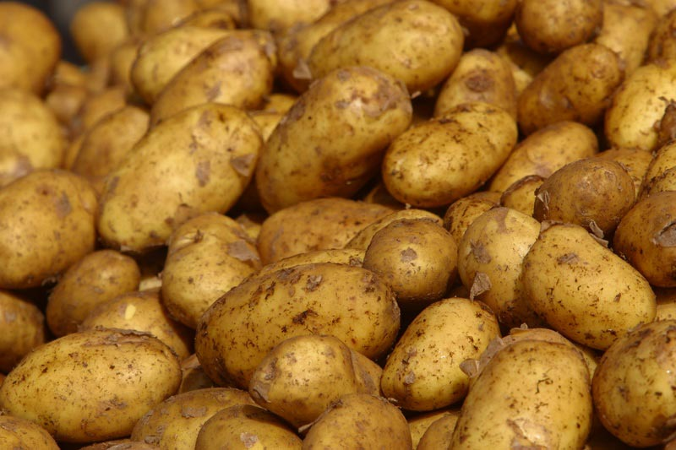
Round 17 - 1840 (1 minute)
There is a need for quicker transportation. Coal, iron, finished products, & raw materials must all be transported from one area of England to another.
In Ireland in the late 1830s a devastating potato famine drove hundreds of thousands of Irish to England. Here was the cheapest of labor possible to build more railroads.
Add 1 more railroad line passing East to west through your town.
Add 5 houses (total 75) and 1 tenement for the new railroad workers.
http://www.koze950.com/wp-content/uploads/2008/05/potatoes.jpg

Slide 21
Round 18 - 1842 (1 minute)
There are some advantages to urban dwellers. City life is very different from the country life. For the small but growing middle classes, a whole new cultural life is available. Museums, theater, opera, restaurants, plays, & concerts are made available.
Whereas before only the aristocrats could afford the arts, but now the middle class enjoys the fine life of culture and good living.
Add 1 theater and 1 museum.
Add 2 private schools for upper class students (mark these schools with the letter “P”).
Add 1 nice house.
http://www.arthurlloyd.co.uk/Olympic/olympic2.jpg

Slide 22
Round 19 - 1845 (45 seconds)
There are no pollution controls so the air in your community looks dark. Windows, walls even trees are covered with layers of soot and coke. The river that once flowed through your quiet village for hundreds of years is now unfit for drinking, bathing, or laundry.
A new disease begins to take the lives of people. Malignant tumors grow in peoples’ bodies and the term cancer is first used in the medical profession.
The average life expectancy for the poor classes is now 30 years of age. Your city is overcrowded and shrouded in factory smoke. The noises, the loss of privacy, & the loss of the family unit shatters the peace of the old ways.
Suicide rates double, then triple.
Add 1 cemetery, 1 jail, and 1 hospital to accommodate the victims of urban life.
http://maggieblanck.com/NewYork/Life.html

Slide 23
Round 20 - 1850 (30 seconds)
By this year several million acres of good English land has been enclosed and sold to private parties who own large estates. Despite the misery this creates for England’s landless poor, the economic benefits for the rich are obvious. These farmers purchase the newest power-driven machinery and can easily feed the working class of England (including the Irish).
The small landowning farmer is crushed by the enclosed commons. They cannot afford the machinery and therefore cannot compete and grow food profitably.
Thousands of these folk leave their villages (where their ancestors had lived for hundreds of years) and move to towns and cities looking for work to feed their families. Some refused to leave but took jobs working for the large landowning farmers.
By the thousands, they moved to the bleak, uninviting towns of the north and the new cotton mills.
Add 20 houses (total 95), 5 tenements, 2 stores, 1 church, 5 factories, and 1 pub, and 2 more nice houses and 1 special house .
http://maggieblanck.com/NewYork/Life.html

Slide 24
What was your experience while playing The Urbanization Game?

