Slide 1
2016 NNCSS
Govern Your Classroom Like a Diplomat, not a Dictator,
and Cultivate a Growth Mindset
Encouragement, Empowerment
& Excellence
Notes:
Thank you for coming to the workshop! Very excited to be hear and share an effective and documented classroom management behavior program.
Before we start, first I’d like to take a consensus of attendees.
How many are 1st year or new teachers?
How many are supervisors or school administrators?
This way I can gear the workshop and make it a useful session for everyone.

Slide 2
Workshop Speaker
Elementary teacher
University instructor
Educational coach
Writer
Aspiring diplomat
Notes:
Now a little about me. I’m pictured here with my cat Riley – he’s my sounding board for presentations when I put a program together.
Currently I teach at the university level but I began, like you, as an elementary school teacher working with 4th then 6th graders.
I was like many of you – first year teacher with a solid background in subject matter but not in classroom behavior management. I would have loved to benefit from the insight and advantage this program offers and you’ll learn today.
This is my experience in my first year as Miss Mace, 4th grade teacher at Valley School, Encino, CA:
24 rowdy, talkative, and hyper 4th graders in a small classroom
I lost my voice within 2 months of teaching because I was constantly asking them to be quiet or talk above them
It was tough, but I returned the following year as an English and Math teacher at the 6th grade level. This was a reprieve! And perhaps the principal knew it. I taught an additional year but then left the field for the professional world. To retain my certificate I was required to attend graduate coursework but at the time, I wasn’t ready. I knew at some point I’d return to teaching so here I am today!

Slide 3
Diplomat vs. Dictator
Opposites don’t attract!
Notes:
The workshop features a classroom management behavior program designed by Time To Teach, a 20-year old organization and program.

Slide 4
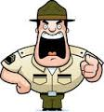
Dictator
Environment:
Authoritarian rule
Permission required
Limits and controls set
Educational Outcomes:
Learning stifled
Communication limited
Motivation affected
Notes:
The workshop features a classroom management behavior program designed by Time To Teach, a 20-year old organization and program.

Slide 5
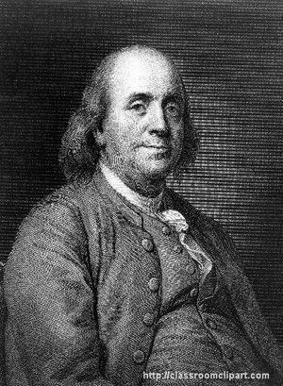
Diplomat
Environment:
Authoritative style
Independence managed
Discipline tempered
Educational Outcomes:
Self-reliance supported
Social competence nutured
Motivation and growth
Notes:
The workshop features a classroom management behavior program designed by Time To Teach, a 20-year old organization and program.

Slide 6
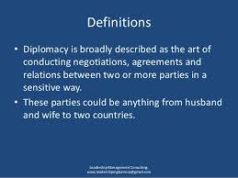
What Is Diplomacy?
Notes:
The workshop features a classroom management behavior program designed by Time To Teach, a 20-year old organization and program.

Slide 7
Diplomat vs. Dictator
Notes:
The workshop features a classroom management behavior program designed by Time To Teach, a 20-year old organization and program.

Slide 8
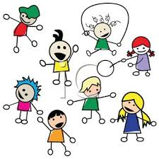
Journey to Diplomacy
From this…
…to this!

Slide 9
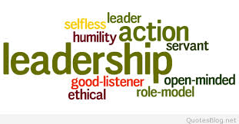
Diplomat Do’s
Set clear expectations.
Active learning.
Don’t sweat small stuff.
Do not punish themselves.
No confrontations.
No empty threats.
No repeated warnings.
Respect students’
class time.
Notes:
The workshop features a classroom management behavior program designed by Time To Teach, a 20-year old organization and program.

Slide 10
Do You Agree?
Students do not necessarily know how to behave.
Rules and routines
should be systematically taught.
An effective discipline program teaches responsible behavior.
Teaching succeeds where punishment fails.
Notes:
The workshop features a classroom management behavior program designed by Time To Teach, a 20-year old organization and program.

Slide 11
Social Studies Application
Civic behavior.
Democratic process.
Leadership development.
Co-authors of a social contract.
Social responsibility and change.
Notes:
The workshop features a classroom management behavior program designed by Time To Teach, a 20-year old organization and program.

Slide 12
Core Components
Self Control
Teach-To’s
Refocus
Classroom Ecology
Unconditional Positive Regard

Slide 13
Self Control
Verbal Communication
Calm is Contagious
Silence is Powerful
Tone-Volume-Cadence
You’ll always get 2nd chance
Non-Verbal Communication
Personal Space-1 ½ to 3 feet
Body Language
Avoiding Power Struggles
Defending Credibility
Past History
Button Pushing-Parents in stores
I Understand
Probably…
Nevertheless
I’m Sorry

Slide 14
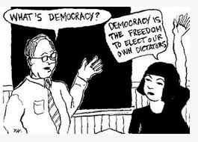
Self-Control with Diffusers
Avoids power struggles
Noncondescending
Matter-of-fact
“I hear you, but so what”
I understand
Probably so
Nevertheless
I’m sorry

Slide 15
Teach To’s
Direct Instruction Model
Model
Lead
Test
I do, We do, You do

Slide 17
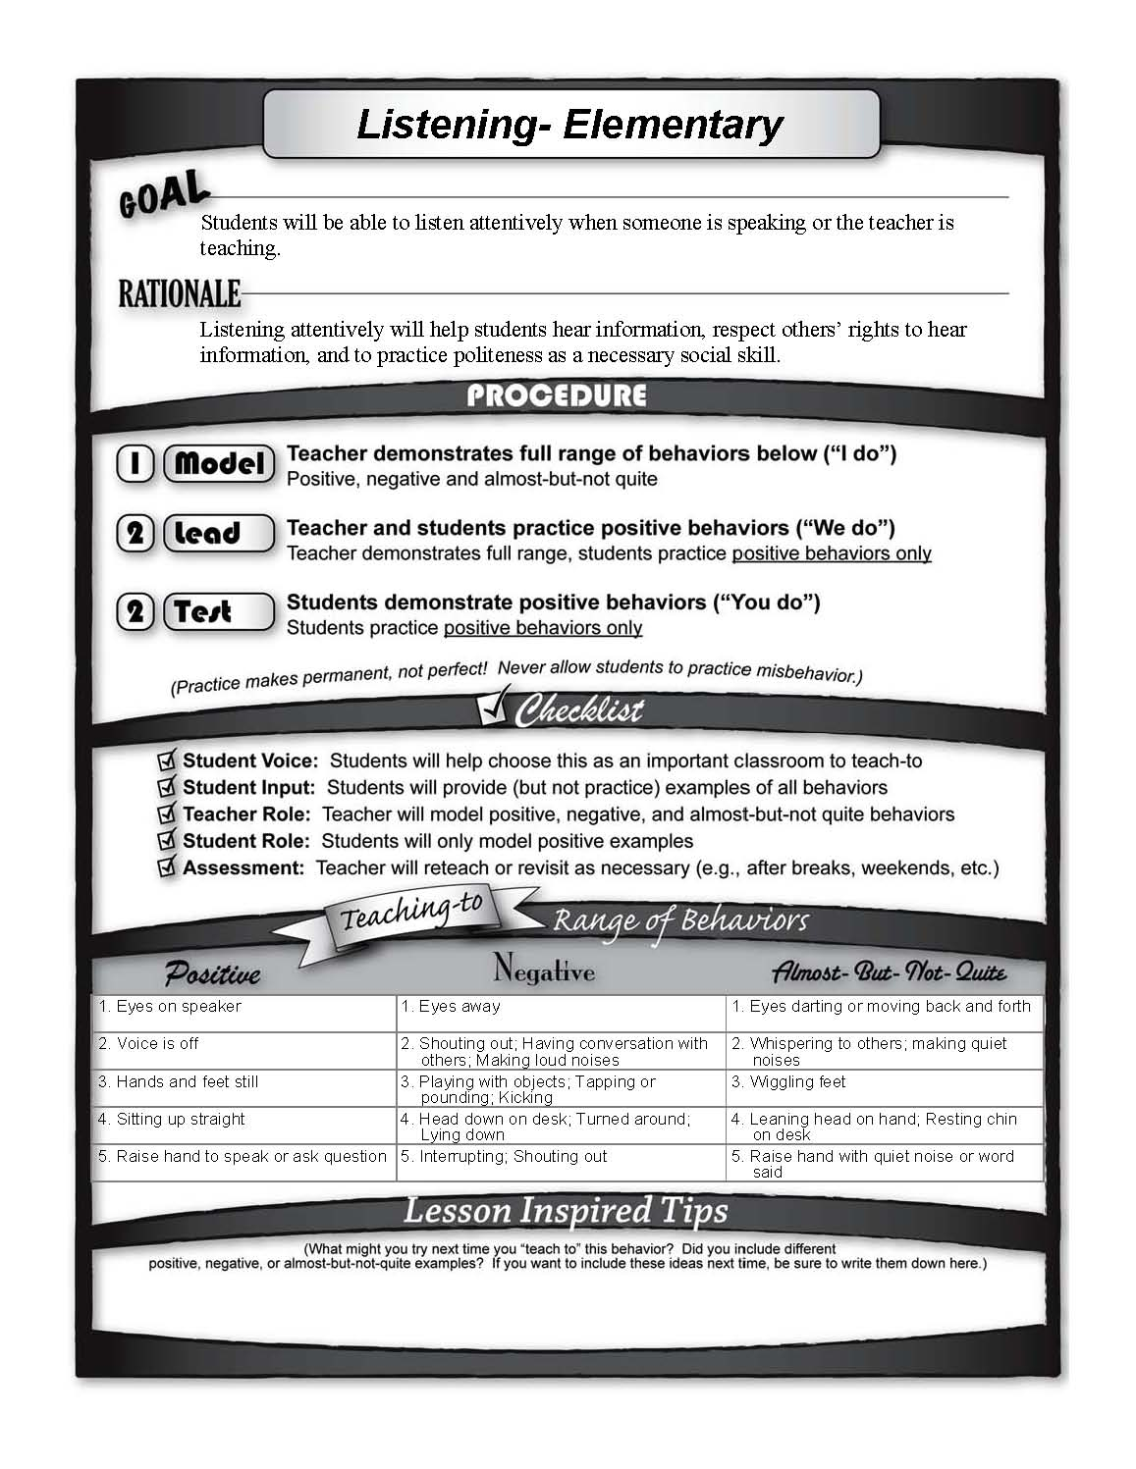

Slide 19
Teach To’s Workshop
Direct Instruction Model
Model
Lead
Test
I do, We do, You do
Emergency Drill
Q&A

Slide 20
TEACH TO’S
Determine the Teach To’s in your classroom/building
New teachers may need to ask the veterans what the key rules should be.
Just posting rules in the classroom is not enough.
Frontload, spend as much time as needed in the beginning to teach these.
Instructional
Time
Academic
Performance

Slide 21
Teach To’s Workshop
Direct Instruction Model
Model
Lead
Test
I do, We do, You do
Emergency Drill

Slide 23
Teach To’s Workshop
Additional applications?

Slide 25
Refocus The Most Powerful Solution to Problem Behavior
Elements Underlying REFOCUSING
Eliminate repeated warnings and/or multiple requests.
Contingently withdraw attention when a problem behavior occurs.
Retain behavioral momentum: a sequence of high probability compliance commands.
Refuse to reach the unbearable limit -- don’t take turns!
5. Developing self-control takes a lot of practice.

Slide 26
REFOCUS FORM
What was your behavior?
What did you want?
What will you do next time?
Are you ready to return to the routine of the class?

Slide 27
Teaching succeeds where punishment fails.
Time for an effective discipline program that teaches responsible behavior.

Slide 28
Discipline the behavior,
not the student.
There is much more to discipline than punishment.
Give kids enough slack, but not enough to interfere with learning. There are no bad kids, but there are bad behaviors.

Slide 29
Turn a disruptive moment into a learning moment
…becomes a “win-win” experience for both student and teacher.

Slide 30
Classroom Management
Two Essential Elements
T.L.C.
Teaching classroom expectations
Looking for performance on expectations (monitoring)
Consequenting behavior – both positive and negative
Identifying classroom expectations - Student Voice
U.P.R. - Unconditional Positive Regard

Slide 31
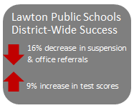
Results!
National program – schools, districts, states.
Documented results and endorsements.
Behavior and discipline problems reduced.
Academic improvement.
Teacher effectiveness.
Beck Academy reduces discipline referrals campus-wide 82%.

Slide 32
Closing Story
The power of self-esteem.
Randy
15 years later
This is why we are teachers!

Slide 33
Thank You !
Contact/Questions
Mary Ann Mace
MaryAnnMace@TimeToTeach.com
www.ProfMace.com
Cell: 818-632-0565

