Slide 1
12th Annual Social Studies conference
Got Grit?
Developing the Right Mindset

Slide 2
NNCSS: Who are we?
The Northern Nevada Council for the Social Studies (NNCSS) is the local affiliate of the National Council for the Social Studies.
Our affiliate was formed in 2003 by Sue Davis and a group of other committed teacher.
We support and advocate for Social Studies education in Northern Nevada.

Slide 3
Please Stand for the National Anthem & the Presentation of Colors
Baylee Parkin will be singing the National Anthem. She is a junior at Reno High School and has been singing and playing piano for 11 years. She plans on attending UNR next year after graduating in 2016. She enjoys her car, all types of music, and being social with her friends.
The Colors will be presented by Hug High School JROTC Color Guard headed by Master Sergeant Beach
Cadet Sergeant Kortney Schatz
Cadet Sergeant Josh Bailey
Cadet Second Lieutenant Alondra Velez
Cadet Colonel Fabian Kovac

Slide 5
TMCC Representative

Slide 6
Welcome!
Thank you to everyone who is participating today in this conference. We have 300 educators and community members here to celebrate and learn more about social studies in Nevada.
7 Districts
5 Charters
18 University/College Students & Professors
2 Private Schools
Most # of Elementary Teachers ever

Slide 7
Logistics
Your personalized agenda is in your folder.
All workshops are located here in the Red Mountain building except for computer lab classes, which are next door in the Sierra bldg.
You must sign in to each breakout session! Please make sure to sign in when you enter the room.
Evaluation: Please fill out as you enjoy your day.
Lunch: Fajitas and salad bar options
In-Service credits will be mailed to you in the next few weeks.

Slide 8
Thank you for sponsoring breakfast!

Slide 9
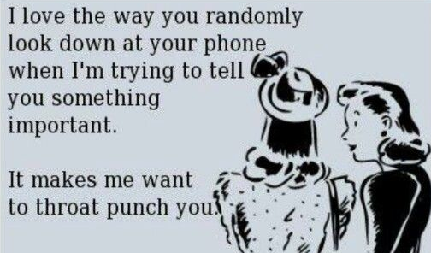
WiFi
SSID: TMCCguest
P/W: SignsofSpring-Mar16

Slide 10
Thank you to the Washoe county School District Department of Professional Learning
And to all the help we’ve received from:
Ellen Thomas, Karen Perisho, Vangie Russell, Christine Alcala-Hanks, Bonnie Damon, April Mendibles, Thomas Lay, & Salwa Zaki

Slide 11
Purchase Raffle Tickets
1 ticket for $1
7 tickets for $5
15 tickets for $10
35 tickets for $20

Slide 12
Thank You! Raffle Prizes Donated By:
Nystrom
One Year Active Classroom License
Reno Vulcanizing Works
Lube, Oil, & Filter
National Automobile Museum
Raffle Basket
Northern Nevada Council for the Social Studies
$200 Southwest gift card
4- $25 Amazon gift cards
5- $10 Starbucks gift cards
World Wide Partnerships
$75 Computer Repair Gift Certificate
Sun Ridge Golf Club
Golf Foursome
Nevada Museum of Art
One Year Membership
Terry Lee Wells Discovery
2 Tickets Social Science Night
Northwest Regional Professional Development Program
Technology basket, Teacher supply basket
Learning Forward Nevada
Teacher Leadership Resources

Slide 13
THANK YOU TO THE NNCSS BOARD!
Katie Anderson
Sarah Brown
Kristin Campbell
Lindsey Clewell
Sue Davis
Christine Hull
Mario Fitzpatrick
Sonia Kretschmer
Vallarie Larson
Laura Moberg
Marcia Motter
Angela Orr
Janet Roberts
Nicolette Smith
Jamie Thomsen
& Chelsea McLeod

Slide 14
Community Partners
Honors Program
Special Collections & University Archives

Slide 15
Social Studies & Social Media

Slide 16
NNCSS 1st Annual Teacher of the Year Dinner & Award Ceremony

Slide 17
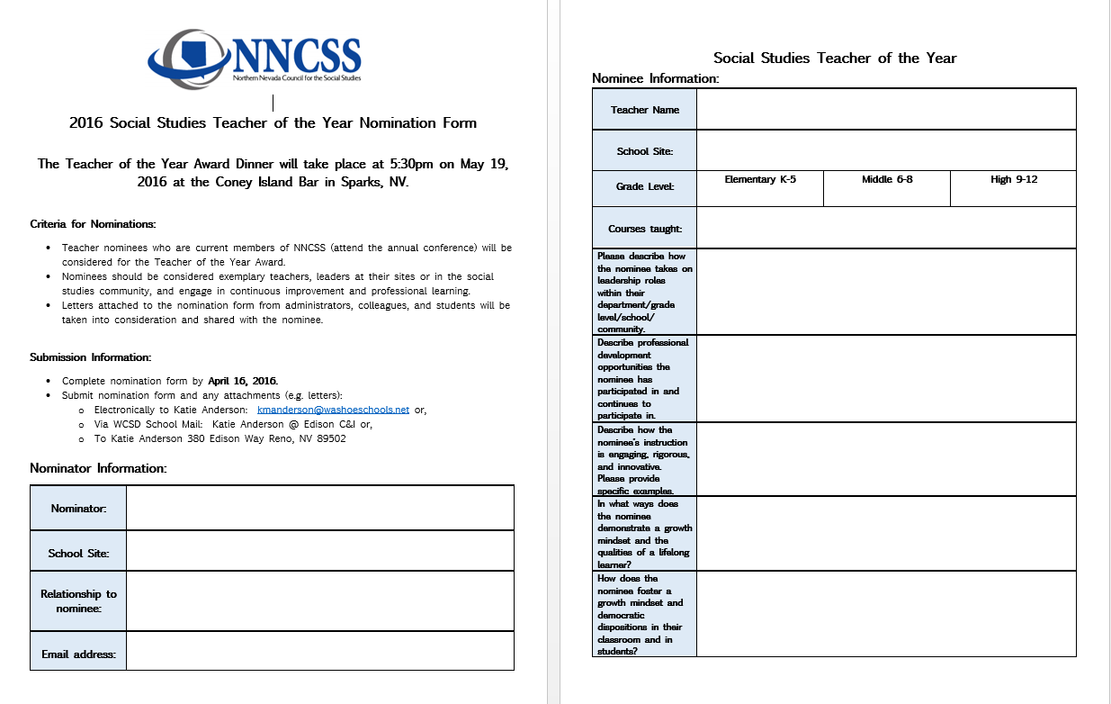

Slide 18
Teacher of the Year
Information
One Elementary, Middle, and High School teacher will be selected.
Please, nominate your amazing colleagues.
The NNCSS board is planning a tremendous evening where we will have the privilege of honoring teachers doing incredible work in their classrooms.
Dates
Nomination Deadline: April 16, 2016
Award Ceremony & Dinner: May 19, 2016

Slide 20
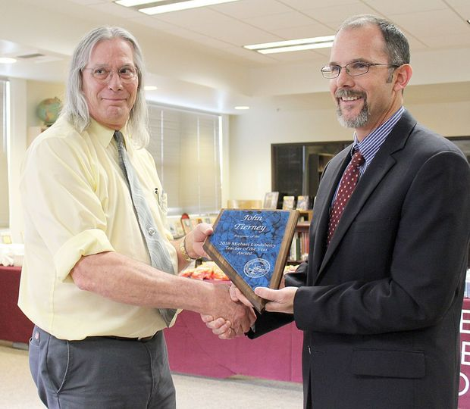
Honoring the Nevada Teacher of the year
Mr. John Tierney
Adobe Middle School
Elko, Nevada

Slide 21
KEY NOTE: Emily Diehl
Emily has 16 years experience in K-12 schools as a teacher and instructional coach. Most of her work in CA schools focused on literacy, the growth mindset, and professional learning communities. Emily translates the latest educational research on mindsets and motivation into growth mindset programs and practices. Emily has collaborated with Mindset Works since 2009 on growth mindset strategies for students, for educators, and for families. She is the editor of the Mindset Works online newsletter and writes often for their blog.

Slide 22
Please head to Breakout session 1
Breakout Session 1 begins promptly at 11:10.

Slide 23
Closing Session

Slide 24
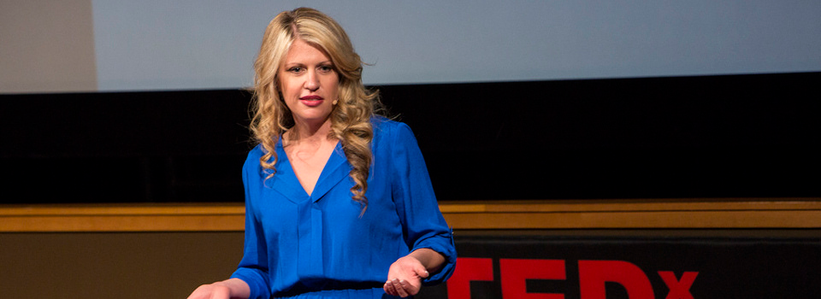
Trish Shafer

Slide 25
NNCSS Social Media
Follow us on Twitter!
Tweet about today’s sessions!
@NNCSSteachers
Follow us on Facebook!
Northern Nevada Council for
Social Studies
Visit our webpage for notes and handouts from the presenters today.
www.nvsocialstudies.org

Slide 26
Raffle begins in one minute!
Please have your raffle tickets out and ready!
Raffle Swap: After the closing, if you received a prize you know you will never use, meet on the left side of the stage for a potential trade.

Slide 27
Thank You! Raffle Prizes Donated By:
Nystrom
One Year Active Classroom License
Reno Vulcanizing Works
Lube, Oil, & Filter
National Automobile Museum
Raffle Basket
Northern Nevada Council for the Social Studies
$200 Southwest gift card
4- $25 Amazon gift cards
5- $10 Starbucks gift cards
World Wide Partnerships
$75 Computer Repair Gift Certificate
Sun Ridge Golf Club
Golf Foursome
Nevada Museum of Art
One Year Membership
Terry Lee Wells Discovery
2 Tickets Social Science Night
Northwest Regional Professional Development Program
Technology basket, Teacher supply basket
Learning Forward Nevada
Teacher Leadership Resources

Slide 28
Social Studies & Social Media

Slide 29
Evaluations
We appreciate your feedback.
We will be at the exits collecting evaluations.
Thank you so much for coming!

