Slide 1
The Hero Journey
Let the Journey Begin …

Slide 2
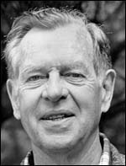
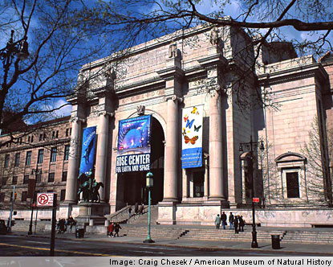
Historical Background
Joseph Campbell
Circa 1984
Museum of Natural History
New York City

Slide 3
The Hero with a Thousand Faces
First Published
in 1948
2008 Edition

Slide 4
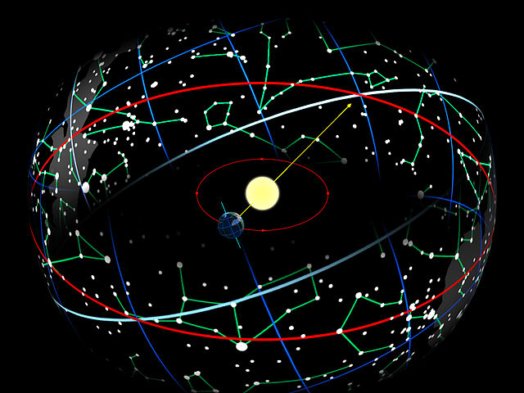
Before Campbell
Egyptian Mystery Schools – Ra/Osiris – The Sun God Journeys through 12 Stages
Moses and the 12 Tribes of Israel (Isis – Ra)
Greek Mystery Schools – Iliad and Odyssey –
12 Labors of Hercules
The Holy Grail – 12 Knights of the Roundtable
Scholarly Overview: Watch Zeitgeist – Part 1 on Netflix

Slide 5
The 12 Stages of the Hero Journey

Slide 6
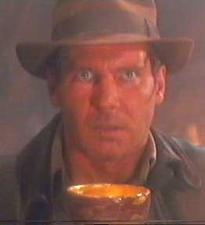
Present Hero Journey Stages Groups …
Lost Coasters – Ordinary World
Lockeans – Call to Adventure & Refusal of the Call
City on the Hill – Meeting the Mentor & Crossing the Threshold
Bull Moose Party – Tests, Allies, & Enemies and Innermost Cave
Fractured Lens – Ordeal & Reward
Battle Born – Road Back & Resurrection
Jefferson: 3 + 1 – Return with Elixir

Slide 7
The Hero Journey Cycle Applied to an Historical Event U.S. & WW II
Ordinary World – Economic Hardship, The Great Depression
The Call to Adventure – WW II Begins 1939
The Refusal of the Call – U.S. Isolationist
Meeting with Mentors – Churchill & Roosevelt meet in August 1941
Crossing the Threshold – Pearl Harbor, Dec. 1941
Tests, Allies, Enemies – 14 million troops, England and Russia = Allies
\

Slide 8
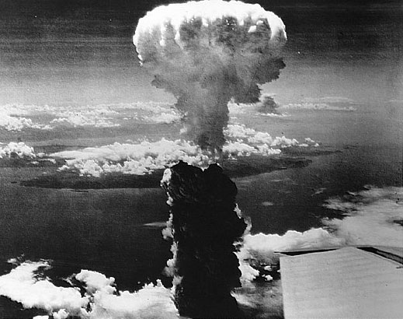
The Hero Journey Cycle Applied to an Historical Event U.S. & WW II
Approach: the Innermost Cave – Iwo Jima, February – March 1945
The Ordeal – D-Day: June 6, 1944 & Hiroshima, August 1945
The Reward – Victory over Germany & Japan
The Resurrection – The troops and the country transformed / changed. U.S. = World Power
Return with the Elixir – Stories, Novels & Films
\

Slide 9
An Historical Event or Historical Person
In Your Group
Use the Hero Journey Storyboard
Present the the Hero Journey Cycle
Use in Your Unit

Slide 10
Your Hero Journey …
Using the Hero Journey model, create a hero journey presentation (5 minutes) and essay (2 to 3 pages) that reflects a specific step-by-step journey from your own life.
Be sure to utilize the Your Hero Journey: Self Introduction Storyboard from WebCampus as a guide. (Meeting the Mentor)
September 24 – Bring Your Hero Journey script, DVD, flashdrive and headphones/earbuds to Media Center @ One Knowledge Center.
Due Date October 1 (15 Points)
May the Force Be With You …

Slide 11
Benefits:
Process Thinking
Depth of Knowledge (DOK)
Spectrum Thinking
Evaluative Thinking
Reflective Thinking
Metaphorical Thinking
Fosters Creativity & Synthesis

Slide 12
Types of Hero/Heroine Journeys Noticed Over Time:
Physical – Run, Swim, Snowboard …
Emotional – Fear, Procrastination, Sabotage ...
Psychological – Relationships, Family, Jobs …
Travel – Foreign Countries … Ireland, France ...

Slide 13
References
The Power of Myth with Bill Moyers (PBS)
The Hero with a Thousand Faces – Joseph Campbell
The Writer’s Journey – Chris Vogler
The Joseph Campbell Foundation

